Slide 1
Digging into Student Data
with Improvement Science
FASD Fall Leadership Conference
9/19/16

Slide 2
The Six Improvement Principles
1. Make the work problem-specific and user-centered.
2. Focus on variation in performance.
3. See the system that produces the current outcomes.
4. We cannot improve at scale what we cannot measure.
5. Use disciplined inquiry to drive improvement.
6. Accelerate learning through improvement networks.

Slide 3
The Improvement Science Paradigm Shift
Accountability Driven Reform | Improvement Science
Cannonballs | Bullets then mortars then cannonballs
Driven by ideology | Driven by evidence
Top down | Classroom up
Refined over years | Refined over weeks
Technical | Adaptive
Punitive | Affirming & aspirational
Encourages adult compliance | Encourages adult learning through reflection, inquiry, hypothesizing, and testing

Slide 4
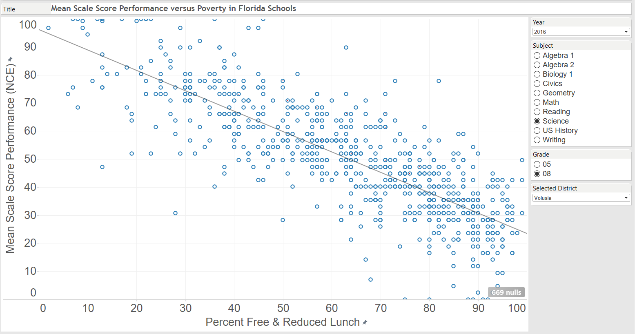

Slide 5
Best Fit Line

Slide 6
Over-Performing
Under-Performing

Slide 8
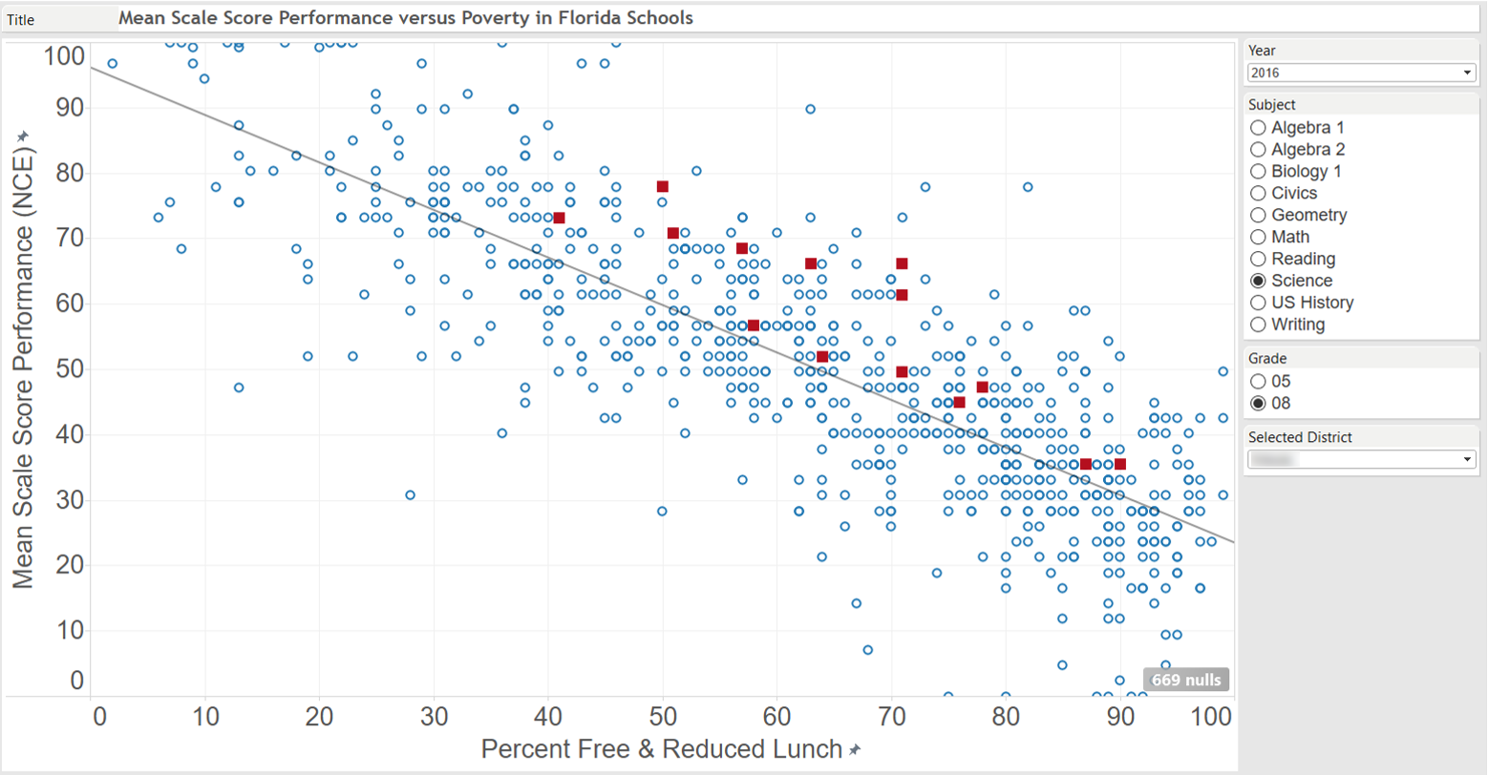

Slide 9
But wait…
might this be explained
simply by having
high performing students?

Slide 10
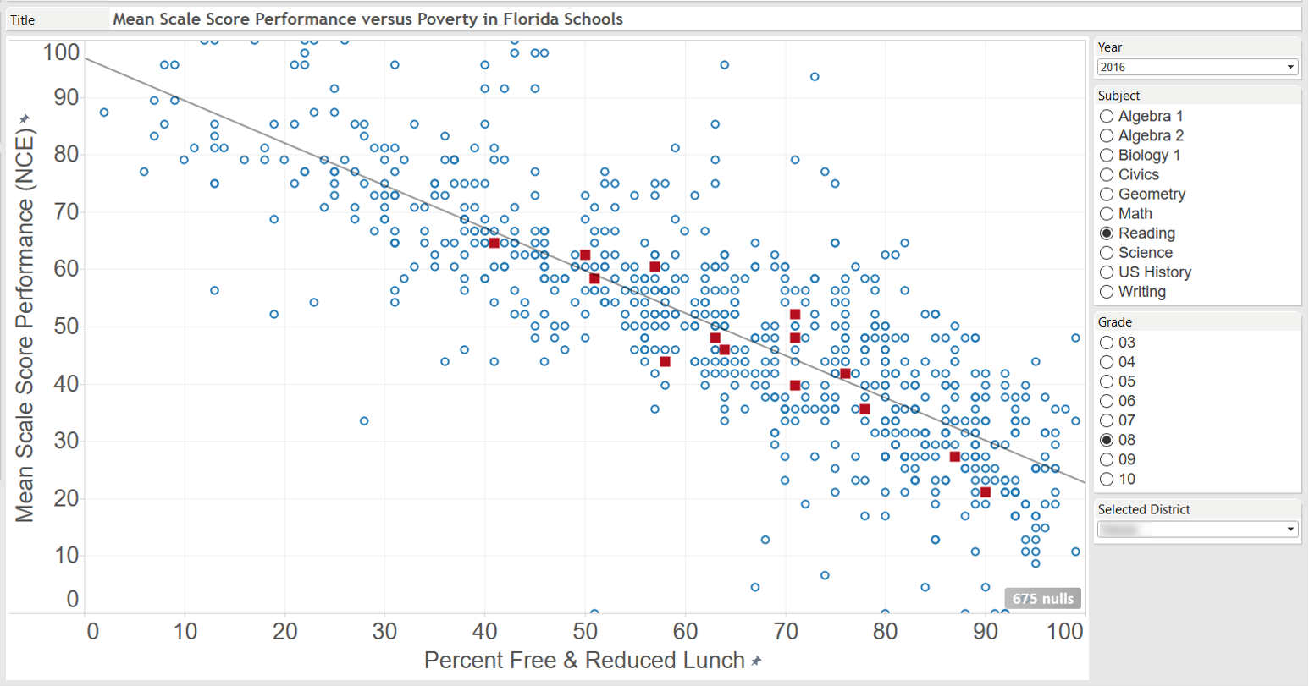

Slide 12
What assumptions
are challenged by this district’s
8th grade science and reading results?

Slide 13
Let’s explore some other results.
What do you see?

Slide 14
So scatter diagrams that account for poverty are useful…
but they have some limitations.

Slide 15
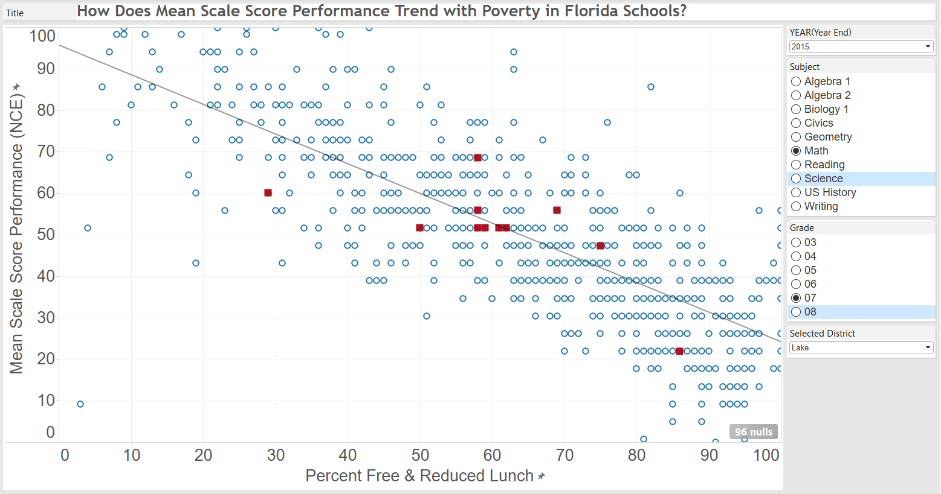
Residuals
Windy Hill
- 15.5
14.1
Lake Virtual
Carver
- 8.7
5.3
East Ridge
- 12.1
Oak Park

Slide 16
Residuals
Windy Hill
- 15.5
14.1
Lake Virtual
Weighted Average Residual Calculation
School | Residual (A) | Students | % Total Students (B) | Weighted Average Component (A*B)
East Ridge | -8.7 | 389 | 13% | -1.2
Gray | 0.1 | 331 | 11% | 0.0
Tavares | -2.8 | 307 | 11% | -.3
Oak Park | -12.1 | 152 | 5% | -.6
Carver | 5.3 | 282 | 10% | .5
Clermont | 1.4 | 238 | 8% | .1
Mt. Dora | -2.1 | 254 | 9% | -.2
Windy Hill | 14.1 | 424 | 15% | 2.1
Umatilla | 9.4 | 188 | 6% | .6
Eustis | -.7 | 317 | 11% | -.1
Lake Virtual | -15.5 | 12 | 0% | -.1
 |  | Total Students |  | Weighted Average Residual
Sum Totals |  | 2894 |  | .9
Carver
- 8.7
5.3
East Ridge
- 12.1
Oak Park

Slide 17
2015 - Math - Grade 7
Stanine | District | Average Residual | Percentile
9 | Dixie | 32.1 | Top 4%
 | Franklin | 23.6
8 | Sarasota | 15.7 | Next 7%
 | Union | 15.0
 | Lee | 14.4
 | Glades | 13.6
 | Collier | 12.8
7 | Washington | 11.8 | Next 12%
 | Walton | 11.7
 | Citrus | 10.6
 | Levy | 9.6
 | Hernando | 9.0
 | Calhoun | 8.7
 | Highlands | 8.6
 | Baker | 7.8
6 | Jackson | 7.5 | Next 17%
 | Charlotte | 7.2
 | Nassau | 6.9
 | Hillsborough | 6.7
 | Lafayette | 5.6
 | Bay | 5.6
 | Santa Rosa | 5.4
 | Gilchrist | 4.5
 | Sumter | 4.0
 | Flagler | 3.7
 | Okaloosa | 3.3
 | Osceola | 3.1
5 | Holmes | 2.7 | Middle 20%
 | Seminole | 1.5
 | Clay | 1.5
 | Bradford | 1.1
 | Lake | 0.9
 | Orange | 0.2
 | Dade | 0.1
 | Palm Beach | 0.0
 | Columbia | -0.3
 | Gulf | -0.4
 | St. Johns | -0.8
 | Marion | -0.8
 | Okeechobee | -1.1
4 | Pasco | -1.3 | Next 17%
 | Madison | -1.4
 | Suwannee | -2.2
 | Monroe | -2.4
 | Alachua | -2.5
 | Pinellas | -2.8
 | Broward | -3.0
 | Brevard | -3.1
 | Escambia | -3.3
 | Putnam | -3.6
 | Hardee | -3.8
 | Gadsden | -4.0
3 | Taylor | -4.0 | Next 12%
 | Manatee | -4.5
 | Liberty | -4.9
 | Desoto | -5.1
 | Leon | -5.3
 | St. Lucie | -5.7
 | Hendry | -6.2
 | Martin | -8.3
2 | Polk | -8.9 | Next 7%
 | Wakulla | -9.3
 | Hamilton | -9.5
 | Volusia | -9.7
 | Indian River | -10.5
1 | Duval | -12.3 | Low 4%
 | Jefferson | -37.0
Weighted Average Residual Calculation
School | Residual (A) | Students | % Total Students (B) | Weighted Average Component (A*B)
East Ridge | -8.7 | 389 | 13% | -1.2
Gray | 0.1 | 331 | 11% | 0.0
Tavares | -2.8 | 307 | 11% | -.3
Oak Park | -12.1 | 152 | 5% | -.6
Carver | 5.3 | 282 | 10% | .5
Clermont | 1.4 | 238 | 8% | .1
Mt. Dora | -2.1 | 254 | 9% | -.2
Windy Hill | 14.1 | 424 | 15% | 2.1
Umatilla | 9.4 | 188 | 6% | .6
Eustis | -.7 | 317 | 11% | -.1
Lake Virtual | -15.5 | 12 | 0% | -.1
 |  | Total Students |  | Weighted Average Residual
Sum Totals |  | 2894 |  | .9

Slide 18
Let’s explore.
What do you see?

Slide 19
Which districts navigate the transition to middle school most successfully?

Slide 20
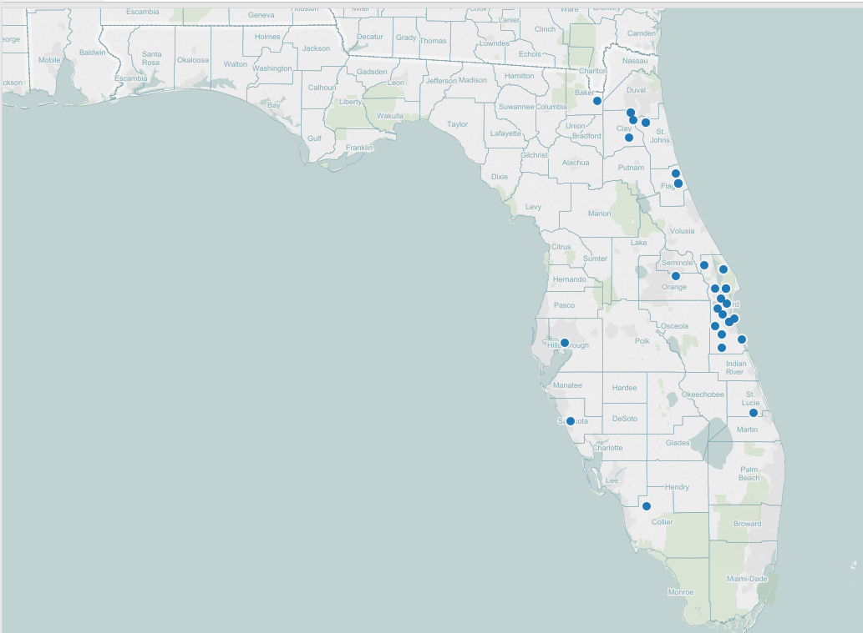
Highest Growth Classrooms
Grade 6
Math
2014-15
K-6
K-8

Slide 21
