Slide 1

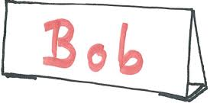
Bell Work
1. Create a name tent
2. Praise Statement
Good job!
Notes:
ALL - Raffle Tickets will be handed out at the door with handouts.
Create a name tent. On the inside of the name tent please draw a picture that represents WHY you chose to become an educator.
On a blank sheet of white paper please write a commonly used praise statement.

Slide 2



Language Matters: Adopting Person First Language
to Foster Growth Mindset
Developed by: Becky Finn, Allison Kanji, Elaine McCann Jenn Michaels, Melissa Mulock
Florida Diagnostic & Learning Resources System & Florida Inclusion Network Region 3
Notes:
Becky - Our thoughts and words impact our actions, which impacts how we perform, which in turn impacts how we think and talk about ourselves. It’s cyclical.
Language Matters: Adopting Person First Language to Foster Growth Mindset
Description:
A teacher’s language and mindset impacts their actions. A teacher’s actions impacts a student’s mindset. A student’s mindset impacts their performance. Person First Language is about respect and dignity and it puts the person – not the condition – first. Mindset is a set of beliefs or a way of thinking that determines one’s behavior, outlook, and mental attitude. In this session, participants will understand the influence of language on mindset. Research on the effects of praise statements and their impact on student engagement and performance will be explored. Bridging the gap from research to practice, participants will learn how to formulate feedback that activates and bolsters a growth mindset in learners. Participants can obtain access to these materials in order to replicate this session with colleagues and/or students.

Slide 3
Notes:
Bring paper copies of FIN FDLRS flier
Becky introduces herself.
Allison introduces herself.

Slide 4

Notes:
Jenn introduces herself.
Jenn – Orient participants to their Materials
FIN FDLRS flier
Note-taking sheets with the brains
Clear and Cloudy Big Idea Reflection Journal (Pink)
White paper

Slide 5

Take Off (Yes – Stand Up)
Touch Down (No – Sit Down)
Notes:
Jenn
Now that you know a little bit about me, I’d like to know a little about you:
We’re going to use “Take off - Touch Down,” a Kagan Cooperative Learning structure to do this so – when you hear a statement that describes you “take off” (stand up). When you hear a statement that does not describe you “touch down” (sit down).
Take off if you have read “Mindset” by Carol Dweck or “Mindset in the Classroom” by Mary Ricci?
Take off if you have presented on mindset.
Take off if you believe you make a difference in this world.
Take off if you believe that your best years are behind you.
Take off if you believe you still have something to learn.
Take off if you believe in the power of “yet”
Take off if you’re happy to be here at the beach.

Slide 6



Group Norms
Engage fully in the learning process
Honor each other’s learning needs
Be solution oriented
Notes:
Jenn
Briefly review norms.

Slide 7
Learning Goal: Participants will use language that promotes a growth mindset.
 | Evidence
4 | I am able to explain research that may support my colleagues’ development of a growth mindset and adoption of practices to activate/bolster a growth mindset in their students.
3 | I am able to formulate feedback that activates/bolsters a growth mindset in others.
2 | I can explain the relationship between language, mindset and improved outcomes.
1 | I can define person first language and mindset.
0 | I am unfamiliar with the concept of person-first language.
Notes:
Jenn
1 minute - start with level 3
Please identify your starting point and then establish your personal learning goal.
Everything we do with you today you can turn around and do with your students in your classroom. We’ll share this presentation and the materials with you to use with your students.
You could even use this scale by just adjusting the level 3 verbiage to say “peers” or “classmates” instead of “students”
And at level 4 just change “colleagues” to “friends and family.”

Slide 8
What causes people to change?
Round Robin
Notes:
Jenn
What causes people to change? Respond to the prompt with evidence to support your answer in a round robin beginning with person number 1. We have 2 minutes total so each person gets about 30 seconds to talk.

Slide 9

Work with your tablemates
Guess the person based on the clues
Come to consensus
Quickly stand up holding your choice
Notes:
Jenn 7 min
Each team needs to find the stack of celebrity cards at their table and spread them out with names facing up.
Now we’ll be participating in a game that will relate with our learning goal and this is a game we would encourage you to play in your classrooms with your students.
Directions are posted as follows: Read the slide
Work with your tablemates
Guess the person based on the clues
Come to consensus
Quickly stand up holding your choice
Facilitator give celebrity card to team who guesses correctly to keep score and will ask a participant to highlight to certain participants to share information re: celebrity’s little-known challenges.
Award prizes to winning team members.

Slide 10

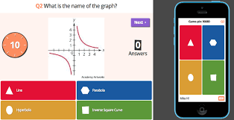
Teacher goes to getkahoot.com and signs in.
Participants go to kahoot.it and enter game code on cell.
Notes:
If you choose not to use the highly engaging game with cards on tables you can use kahoot as long as everyone has a device connected to the internet.
Kahoot 5:00 (instead of Celebrity Name Game w/ cards)
Facilitator goes to Getkahoot.com
Participants go to kahoot.it and enter game code on cell

Slide 11
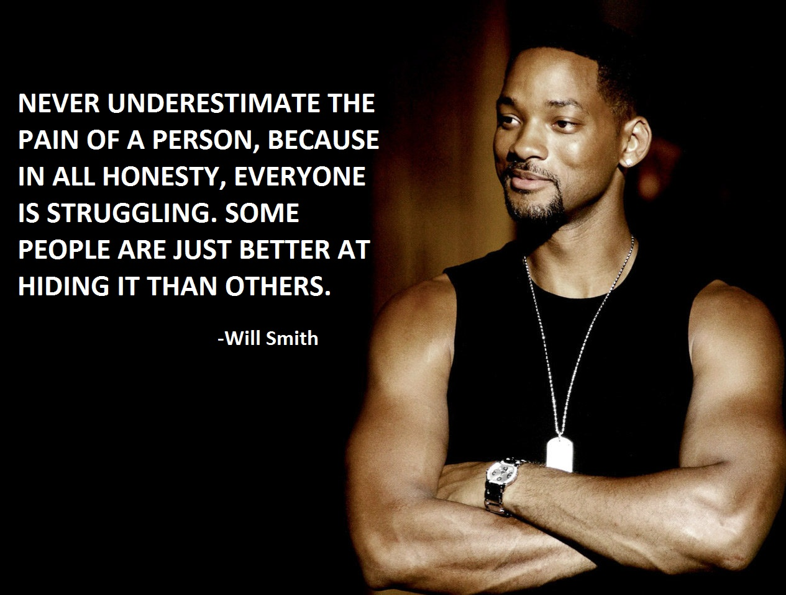
Will has dyslexia and ADHD. Will said, “People don’t think of me as disabled and its great, because I have worked hard all my life to be treated like anyone else. I don’t want anyone to look down on me.
Notes:
“You’ve heard this, but did you know…”
Participants share out
Willard Carroll "Will" Smith, Jr is an American actor, producer, rapper, and songwriter. He has enjoyed success in television, film, and music. In April 2007, Newsweek called him "the most powerful actor in Hollywood".^{[5]} Smith has been nominated for four Golden Globe Awards, two Academy Awards, and has won four Grammy Awards.
He is the only actor to have eight consecutive films gross over $100 million in the domestic box office, and 11 consecutive films gross over $150 million internationally and the only one to have eight consecutive films in which he starred open at the number one spot in the domestic box office tally.^{[6]}
Will Smith is ranked as the most bankable star worldwide by Forbes.^{[7]} As of 2014, 17 of the 21 films in which he has had leading roles have accumulated worldwide gross earnings of over $100 million each, five taking in over $500 million each in global box office receipts. More so, as of 2014, his films have grossed $6.6 billion in global box office.
Now will the person who has this celebrity’s card share what we might not know about him? (underlined portion of large laminated card)

Slide 12
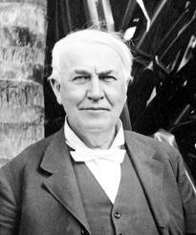
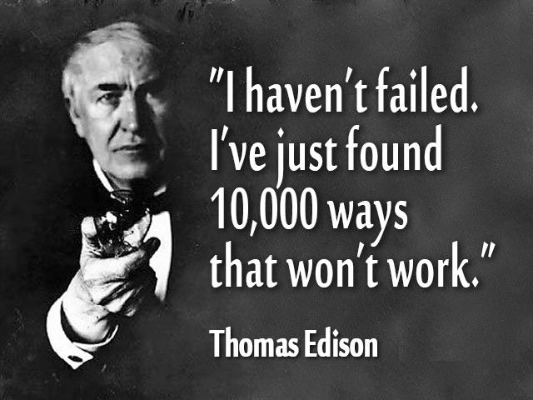
Thomas struggled with math, did not read until 12 years of age. His teachers told him he “wasn’t smart.”
Notes:
Jenn
1,093 US Patents, invented electric light bulb, motion picture camera, struggled with math and didn’t learn to read until age 12. Teachers told him he “wasn’t smart.”
Now will the person who has the Thomas Edison card share what we might not know about him? (underlined portion of large laminated card)

Slide 13
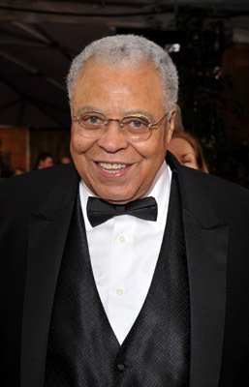
“One of the hardest things in life is having words in your heart that you can’t utter.”
James Earl Jones
James overcame a stutter that so embarrassed him, he refused to speak in school.
Notes:
James Earl Jones is an American actor who has won many awards, including a Tony Award and Golden Globe Award for his role in The Great White Hope. Jones has won three Emmy Awards, including two in the same year in 1991, and he also earned an Academy Award nomination for Best Actor in a Leading Role in the film version of The Great White Hope. He is also known for his voice acting, most notably as Darth Vader in the Star Wars film series and Mufasa in Disney's The Lion King. What may be surprising to some is that James overcame a stutter that so embarrassed him, he refused to speak in school.
Now will the person who has this celebrity’s card share what we might not know about him? (underlined portion of large laminated card)

Slide 14
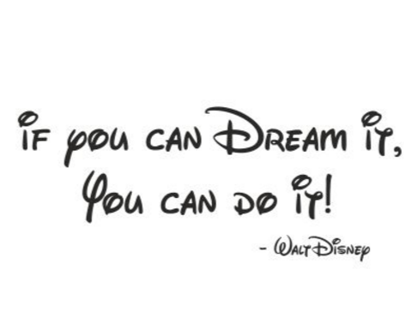
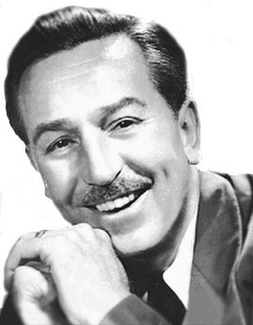
Walt Disney did not learn to read until he was nine.
He drew pictures to help him remember what he was learning.
Notes:
Jenn
22 Academy awards, 7 Emmy awards, famous entrepreneur and animator
Now will the person who has the Walt Disney card share what we might not know about him? (underlined portion of large laminated card)

Slide 15
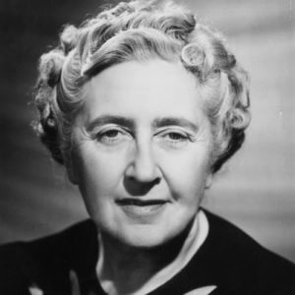
“The popular idea that a child forgets easily is not an accurate one. Many people go right through life in the grip of an idea which has been impressed on them in very tender years.”
– Agatha Christie
Agatha had a learning disability called dysgraphia, which prevented her writing from being legible or easily understood. She had to dictate all 100-plus of her novels, stories and plays.
Notes:
Jenn
She comes in 3rd in the Guinness Book of World Records for most widely published books behind only Shakespeare and the bible.
Now will the person who has the Agatha Christie card share what we might not know about him? (underlined portion of large laminated card)

Slide 16
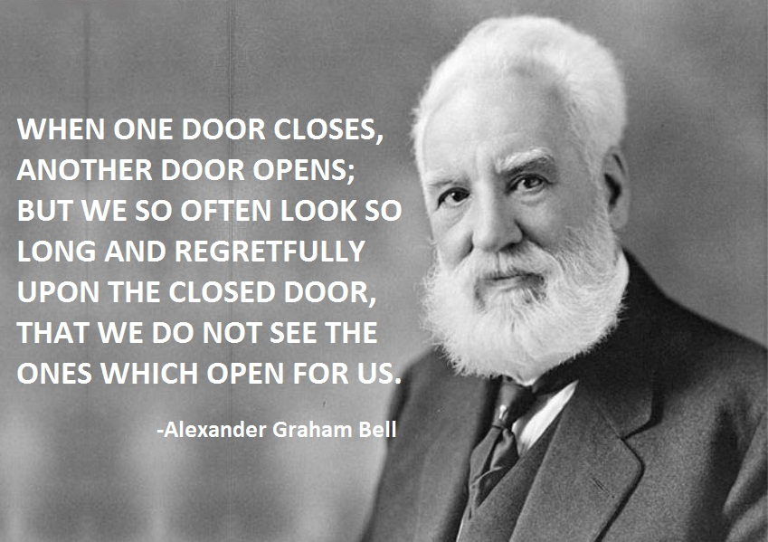
Alexander had dyslexia and struggled in school, except in the area of science.
Notes:
Well known as the inventor of the telephone, Alexander Graham Bell was actually attempting to find a way to make deaf people hear. His mother was slowly becoming deaf when Alexander was only 12 years old making him extremely sensitive to the needs of people with disabilities. Once older, he was constantly seeking a way to cure them through technology. His research on hearing and speech further led him to experiment with hearing devices which eventually culminated in Bell being awarded the first U.S. patent for the telephone in 1876.
Bell enjoyed researching and inventing in other arenas as well. He formed the Aerial Experiment Association and created several flying machines. In fact, the first powered machine to be flown in Canada was developed by Bell. He also set a world record for speed in a hydrofoil that he invented.
Today Alexander Graham Bell is also well know as one of the founders of the National Geographic society.
Now will the person who has this celebrity’s card share what we might not know about him? (underlined portion of large laminated card)

Slide 17
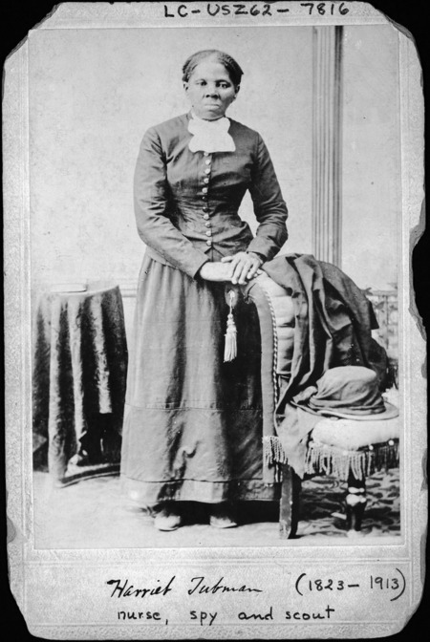
“I freed a thousand slaves. I could have feed a thousand more if only they knew they were slaves.”
– Harriet Tubman
As a teenager, Harriet Tubman suffered a traumatic brain injury that caused a lifetime of seizures.
Notes:
In 1849, fearing that she would be sold and separated from her family, this person plotted her escape. By night, she followed the North Star and relied on the Underground Railroad. She soon returned to Maryland to lead members of her family to freedom. Under cover of darkness, she employed an arsenal of deceptive tactics and tricks to conceal her identity. Repeatedly returning to the South, she led approximately 70 people to safety.
In 1863, she led a group of black soldiers and scouts on surveillance missions along the Southeastern seaboard and worked with Col. James Montgomery to lead a raid on the Combahee River in South Carolina in which 700 slaves were freed.
Now will the person who has this celebrity’s card share what we might not know about him? (underlined portion of large laminated card)

Slide 18
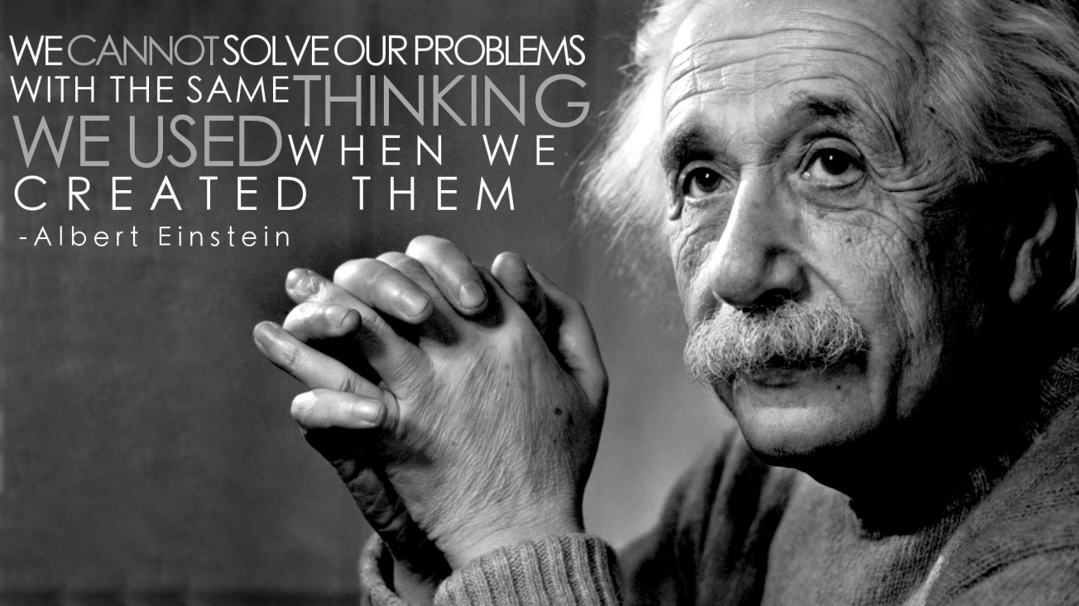
Albert Einstein was kicked out of school for behavioral problems; his teachers said he could not learn.
He did not learn to read until he was nine years old.
Notes:
Nobel Prize in Physics, E = mc2,
Now will the person who has the Albert Einstein card share what we might not know about him? (underlined portion of large laminated card)

Slide 19
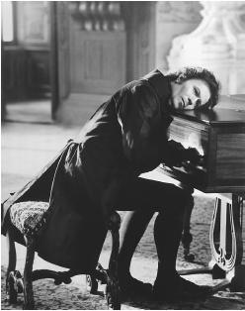
“The barriers are not erected which can say to aspiring talents and industry, Thus far and no farther.”
Ludwig van Beethoven
In about 1800 his hearing began to deteriorate, and by the last decade of his life he was almost totally deaf. He gave up conducting and performing in public but continued to compose; many of his most admired works come from this period.
Notes:
Ludwig van Beethoven was a German composer and pianist. A crucial figure in the transition between the Classical and Romantic eras in Western art music, he remains one of the most famous and influential of all composers.
Now will the person who has this celebrity’s card share what we might not know about him? (underlined portion of large laminated card)

Slide 20
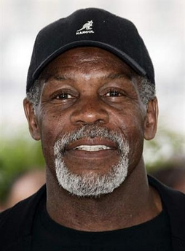
“If we talk about literacy, we have to talk about how to enhance our children’s mastery over the tools needed to live intelligent, creative, and involved lives.”
- Danny Glover
Danny was placed in a class for students with cognitive difficulties until he was in high school.
He did not learn to read or write until after he graduated.
Notes:
Jenn
Danny Glover is an American actor, film director and political activist. Glover is well known for his roles as Mr. Albert Johnson in The Color Purple, Michael Harrigan in Predator 2, corrupt cop James McFee in Witness, Detective Sergeant Roger Murtaugh in theLethal Weapon film series, Colonel Isaac Johnson in Shooter, Detective David Tapp in Saw, and George Knox in Angels in the Outfield. He has also appeared in many other movies, television shows, and theatrical productions. He is an active supporter of various humanitarian and political causes.
Now will the person who has this celebrity’s card share what we might not know about him? (underlined portion of large laminated card)

Slide 21
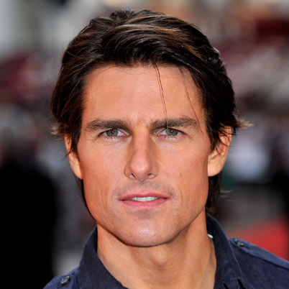
“I always look for a challenge and something that’s different.”
Tom Cruise
Tom was diagnosed with dyslexia when he was 7 years old. He calls himself “functionally illiterate.”
Notes:
Known as an A-list actor and producer, Tom Cruise is the star of many box office hits, including Risky Business, A few Good Men, The Firm, and Jerry Maguire. He has an estimated net worth of $450 million which makes him one of the highest paid actors.
Now will the person who has this celebrity’s card share what we might not know about him? (underlined portion of large laminated card)

Slide 22
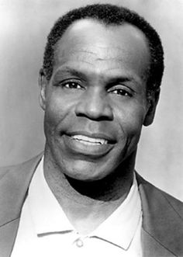
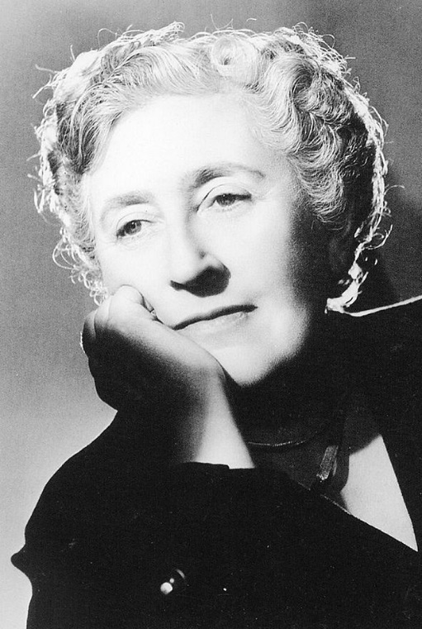
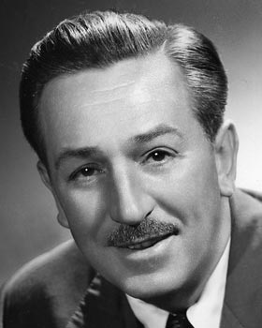
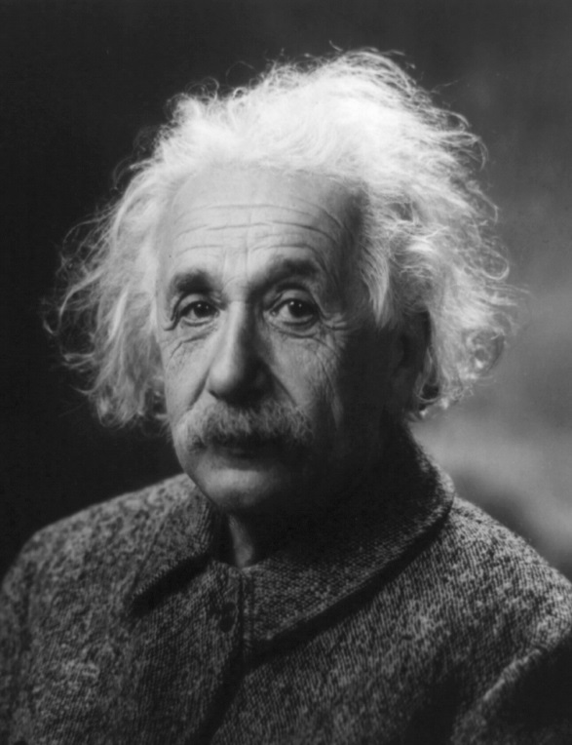
What do all of these people have in common?
Rally Robin
Notes:
Jenn
Turn to your shoulder partner and rally robin what all of these people had in common.
They are all known for their accomplishments, not their challenges. They have resiliency.
Each of these people has a certain kind of mindset which is necessary to overcome adversity
Rally Robin

Slide 23
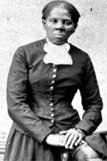
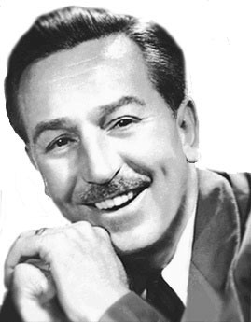
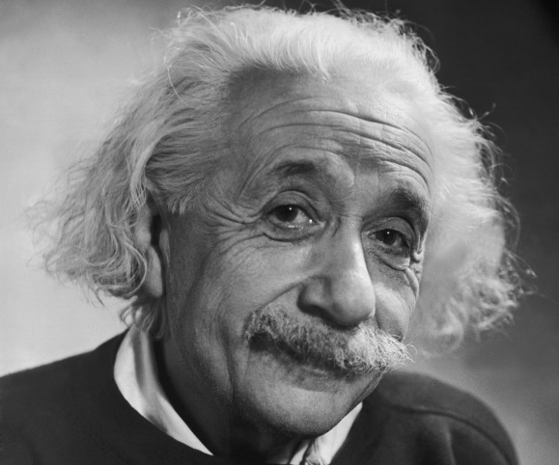
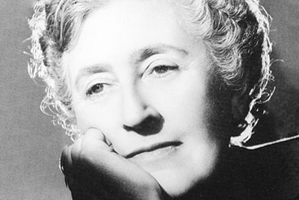
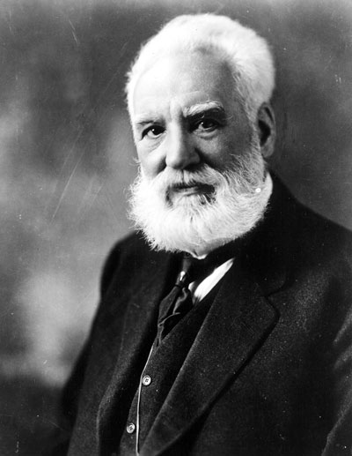
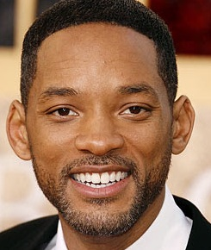
What do all of these people have in common?
Notes:
If you choose to use some of the slides we’ve hidden with other celebrities you can unhide this slide and adjust for discussion of commonalities.
Turn to your shoulder partner and discuss what all of these people had in common.
They are all known for their accomplishments, not their challenges. They have resiliency.
Each of these people has a certain kind of mindset which is necessary to overcome adversity.

Slide 24

Language Matters
Sticks and Stones
1 out of every 5 Americans have a disability
Every individual regardless of gender, race, age, ability deserves dignity and respect
The way we talk about people makes a difference
People can adopt an identity or a mindset based on our words
Notes:
Allison
In the celebrity name game we just played we did not describe Thomas Edison as a dyslexic inventor or Agatha Christie as a dysgraphic author. In fact, we didn’t even have to reveal their disability for many of you to identify who was being describing. When we use Person First Language we recognize that there are a multitude of descriptors for any person and so we focus on putting the person before any challenging condition they might have.
We use Person First Language because words matter.
The Sticks and Stones adage is a lie.
1 out of every 5 Americans has a disability;
1 out of every 6 students has a disability
Every individual regardless of gender, race, age, ability deserves dignity and respect
The way we talk about people makes a difference.
People can adopt an identity or a mindset based on our words.
Many people with disabilities prefer the Person First Language model but it is important to note that some do not. Naturally, the person with the disability has the right to identify whatever language formation they feel is most appropriate.
1 in 6 students have a disability in America.
https://www.cdc.gov/ncbddd/developmentaldisabilities/about.html
https://www.census.gov/newsroom/releases/archives/miscellaneous/cb12-134.html
http://www.usatoday.com/story/news/nation/2015/07/30/american-adults-disability/30881975

Slide 25
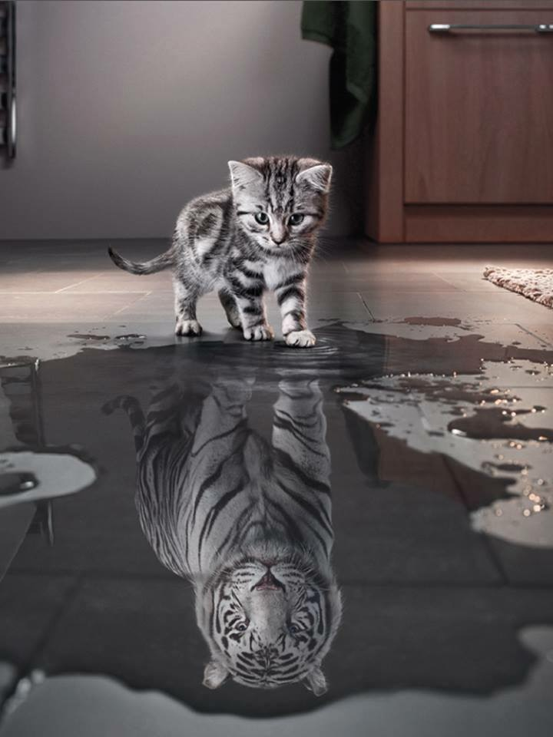
“mindset”
(noun)
a set of beliefs or a way of thinking that determines one’s behavior, outlook, and mental attitude.
Notes:
Allison
Mindset is a set of beliefs or a way of thinking that determines one’s behavior, outlook, and mental attitude.

Slide 26


Language Matters
Notes:
Allison
Carol Dweck is a researcher at Stanford who tested her theory of mindset and her research demonstrates that language really does matter. Much of what we share with you today comes from her book, Mindset.

Slide 27

Dweck’s research has shown that most people
have one of two Mindsets:
Fixed Mindset or Growth Mindset
Notes:
Allison
Your brain is like a muscle in that it can grow!

Slide 28

Growth Versus Fixed Mindset Video
Notes:
Allison
1:15

Slide 29
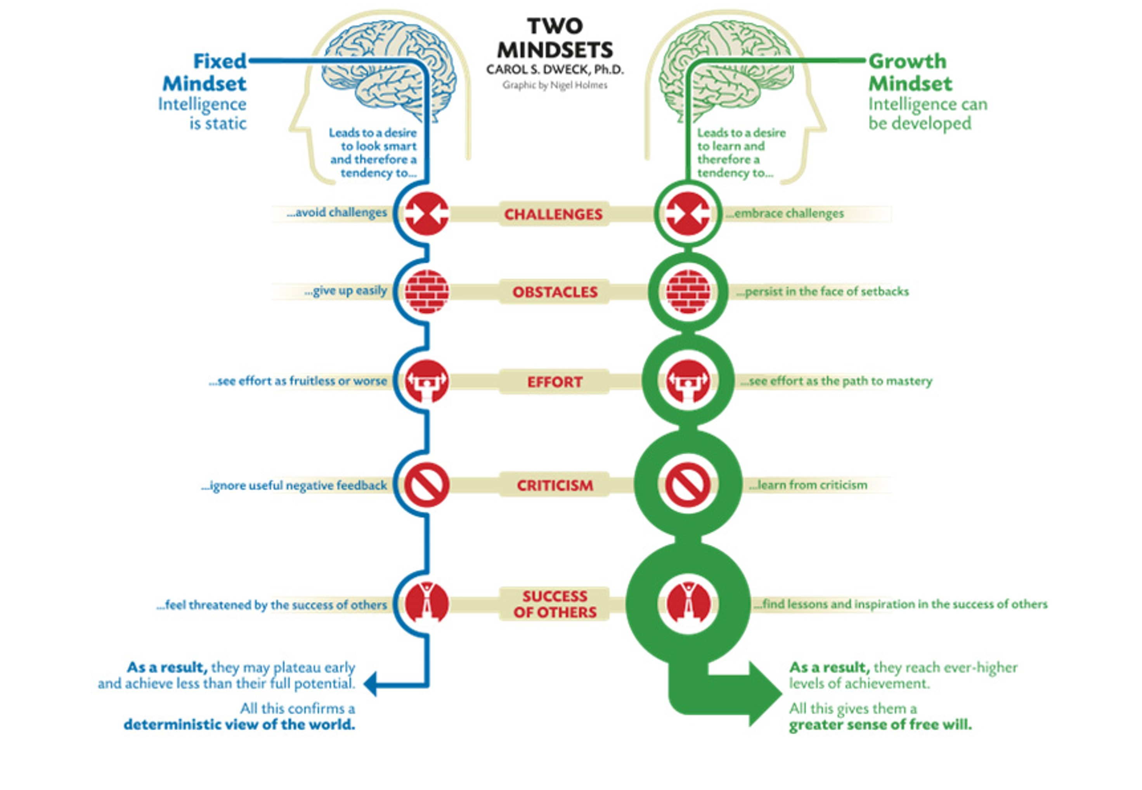



Avoids challenges
Embraces challenges
Gives up easily
Persists in the face of setbacks
Sees efforts as fruitless
See effort as path to mastery
Ignore useful or negative feedback
Learns from criticism
Feels threatened by the success of others
Finds lessons and inspirations in the success of others
Plateau early; achieve less than their full potential
Reach higher level of achievement
Results in
Notes:
Allison
5 min
Introduce handout w graphic as you discuss differences between fixed and growth mindsets and participants use guided notes.
Students with a FIXED mindset believe their basic abilities, their intelligence, their talents, are just fixed traits that really don’t change over time.
Students with a GROWTH mindset understand that their talents and abilities can be developed through effective instruction, effort, and persistence. They don’t necessarily think everyone’s the same but they believe everyone can do well and get smarter if they work at it.
CHALLENGES:
When faced with a challenge students with a FIXED mindset feel threatened and don’t want to stretch or take a risk for fear of losing their “SMART” status so they AVOID challenges.
Students with a GROWTH mindset feel excited about opportunities to learn and grow. They are not afraid to seek help and support when its needed so they EMBRACE challenges.
OBSTACLES:
When a student with a FIXED mindset encounters an obstacle they GIVE UP EASILY.
Students with a GROWTH mindset, on the other hand, PERSIST in the face of setbacks.
EFFORT:
Students with a FIXED mindset see effort as FRUITLESS or worse. They say if you have to try you’re just not good at it.
Students with a GROWTH mindset see effort as a PATH TO MASTERY, recognizing that the amount of effort they put forth relates directly to their success with challenging goals and their satisfaction with their outcomes.
CRITICISM:
For a person with a FIXED mindset criticism is not useful. They might respond to a suggestion with, “I’m never good enough so why should I even try? I really don’t care.”
In contrast, a person with a GROWTH mindset LEARNS from criticism and believes they are never finished improving.
SUCCESS:
Folks with a FIXED mindset feel THREATENED by the success of others.
Whereas people with a GROWTH mindset are INSPIRED by the success of others.
DQ 2 Design Question 2: What will I do to help students effectively interact with new knowledge?
6. IDENTIFYING CRITICAL CONTENT

Slide 30
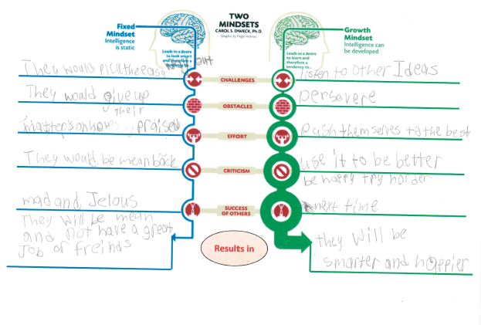
Notes:
Allison
When we were providing this professional development for the faculty of one of the elementary schools we support there were 3 students in the room. It was pre-planning and they were teachers’ kids. I kind of expected the kids to be on a device or coloring or doing something else to occupy their time but when I realized they were paying attention to what we were teaching the teachers I gave them the guided note taking device too. It was a little last minute so this little girl who is going into 4th grade had to paraphrase since she wouldn’t have time to copy everything from the previous slide. Whoa! Look at all she learned. The paraphrased version gives us better feedback as to what she understands and what needs clarification. For instance, the last line of fixed vs growth demonstrates a need for a clarifying conversation but the rest of the notes are spot on.

Slide 31
Educator’s Core Beliefs
FIXED | GROWTH
Success comes from access to effective instruction, effort, and persistence.
Success is determined by genetics and environment.
Some kids are smart and some just aren’t.
Each student has the capacity to succeed.
With hard work and appropriate support most students can achieve at high levels.
No one can override or significantly influence a student’s profile.
Notes:
Allison

Slide 32

“You only have to know one thing:
You can learn anything.”
-Khan Academy
Notes:
Allison
If you have a growth mindset…you can learn anything…which includes how to develop a growth mindset

Slide 33

Mindset isn’t just about believing!
Notes:
Allison
1 min
Mindset is more than just believing. It requires ACTION. It’s about acting on those beliefs-living them out each day. Your beliefs are evidenced in:
How we feel about and talk with students...
How we plan instruction...
How we set up and guide the classroom...
How we use assessment and feedback...

Slide 34

Write down a commonly used praise statement.
Notes:
Allison
Remember when you came in we asked you to write down a commonly used praise statement. If you didn’t have time as you came in please jot a quick praise statement on the white piece of paper.

Slide 35

Snowball Fight!
Notes:
Allison
Now stand up. Crumple up your praise statement into a snowball. When I say go, throw your snowball as far as you can and then grab a new snowball and sit down.
Why did we do that? You’ve been sitting a while and we know standing boosts you’re the oxygen and glucose levels in your brain by 10% so you can pay close attention to the critical content we’re about to share.
Don’t open your snowball YET, just put it to the side and we’ll come back to it.

Slide 36

Video - Research on Praise and Mindset
Notes:
Allison

Slide 37
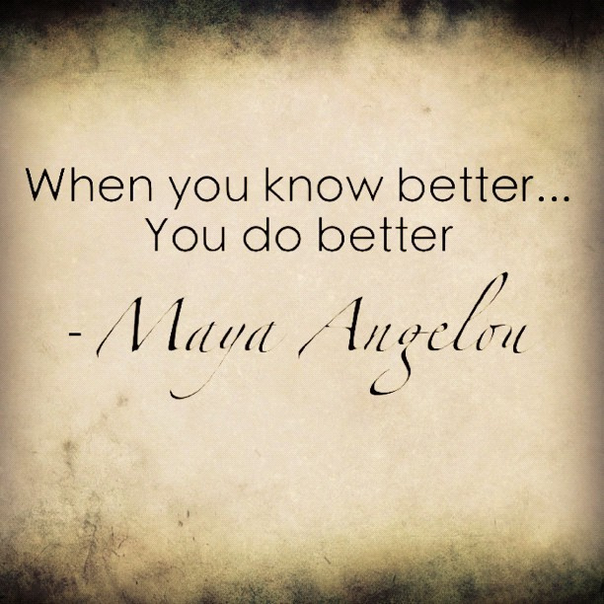
Notes:
Becky
When I first learned about this research I had a little fixed mindset moment where I thought, “Oh no! All those, kids, all those years… How many hundreds of times did I say, “You’re so smart?!” But then the words of Maya Angelou ushered me back into a growth mindset and I decided to forgive myself and move forward because, “When you know better, you do better.”
So if you had a little oh no moment please forgive yourself.
Turn to your shoulder partner and say, “Let it go.”
Now let’s talk about how we can DO BETTER.

Slide 38
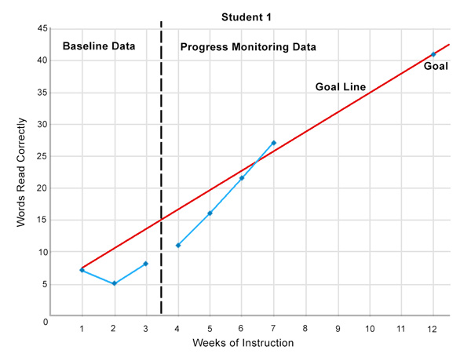
Emphasize Progress and Improvement
Notes:
Becky
Help students become aware of where they ARE, where they NEED to be, and engage them in the process of determining HOW they can get there.

Slide 39

Praise Risk-Taking and Effort
Notes:
Becky
Praise students for taking risks and trying something they knew was going to be challenging.
Praise them for their effort and persistence.

Slide 40
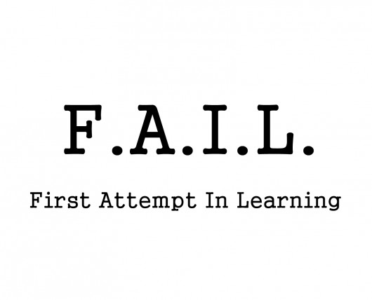
Notes:
Becky
Consider also posting growth mindset inducing quotes in your classroom like this one from Dr. Abdul Kalam and perhaps some of the quotes from the celebrities we learned faced some significant challenges but had the growth mindset to overcome obstacles and view barriers as invitations to innovation!

Slide 41
Notes:
Becky
Remind kids that they haven’t failed, they’ve just found a few ways that won’t work.

Slide 42
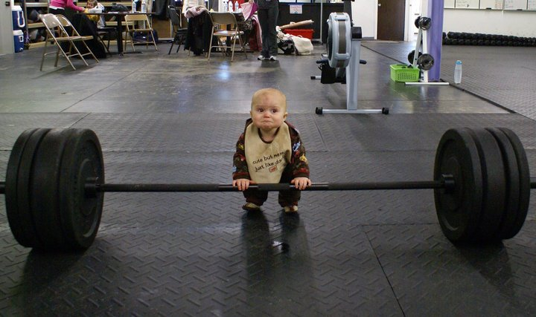
I CAN’T DO THIS
YET!
Notes:
Becky
Whenever a student says, “I can’t do this” add the word “yet” to the end of that statement. You can’t do this YET!

Slide 43

Teach students that just like building muscles, carving new neural pathways TAKES TIME and REPETITION.
Notes:
Becky
Acknowledge that sometimes learning isn’t fast. Teach students that just like building muscles, carving new neural pathways TAKES TIME and PRACTICE.

Slide 44

Open your snowball
Evaluate the praise statement.
Rewrite if needed to be growth-mindset inducing.
Share with your shoulder partner.
Notes:
Becky
2 min
Start by evaluating the praise statement on your snowball to determine if it promotes a fixed or growth mindset. Reword it to make it growth mindset praise.
Now use the next 2 minutes to generate your own list of growth mindset inducing praise statements. We’ll share after that using a cooperative learning strategy.
Now we want to give you an opportunity to add several growth mindset inducing praise statements to your repertoire.
Stand Up, Hand Up, Pair Up - share your growth mindset inducing praise statements until the 2 minute timer dings.

Slide 45
Praising Others
Fixed
Growth
That’s perfect!
You are so smart!
Your drawing is wonderful; you are so talented.
You are a natural athlete. You might be the next LeBron James.
You always get good grades; that makes me happy.
You pay such close attention to detail!
You work hard in this class and it shows!
What strategy did you use to make that drawing look so realistic?
I find your determination on that field inspiring! Keep practicing, and you will see great results!
You should be proud of the effort you put forth to earn those grades!
Notes:
Becky
Take a minute to read the following statements and tell your shoulder partner whether you think the statements are Fixed or Growth.
FIXED. Can you think of some ways to turn these into growth mindset inducing praise statements?
Remember to praise effort, endurance, strategy-selection and improvement, rather than talents or intelligence.

Slide 46
Learning Goal: Participants will use language that promotes a growth mindset.
 | Evidence
4 | I am able to explain research that may support my colleagues’ development of a growth mindset and adoption of practices to activate/bolster a growth mindset in their students.
3 | I am able to formulate feedback that activates/bolsters a growth mindset in others.
2 | I can explain the relationship between language, mindset and improved outcomes.
1 | I can define person first language and mindset.
0 | I am unfamiliar with the concept of person-first language.
Notes:
Becky
1 min
Please identify your level on the scale now and determine whether your personal learning goal was met.

Slide 47

Clear & Cloudy Reflection
Evaluation: 4 questions
FASD Survey
Growth Mindset Survey
Door Prizes
Notes:
Becky

Slide 48


Want to know more?
Becky Finn
Elizabeth.Finn@FDLRSaction.org
Allison Kanji
Allison.Kanji@FDLRSaction.org
Jennifer Michaels
JMichaels@contactFIN.com
Notes:
Becky
Check out additional Growth Mindset resources on the FLDOE website.
http://www.fldoe.org/teaching/just-for-teachers-community/growth-mindset/

