Slide 1
Induction and
Mentoring
Florida Association of Staff Development

Slide 2


Logan and Lindsey
MCPS Induction Team
Notes:
Introduction

Slide 3

Think-Pair-Share
“The teachers hired today are the teachers for the next generation.
Their success will determine the success of an entire generation of students. Their success can be ensured by providing them with a comprehensive, coherent professional development program.”
~Harry K. Wong
Notes:
Talking Point: Effective teachers manage to produce better achievement regardless of which curriculum materials, pedagogical approach, or reading program is selected (Allington, 2003).

Slide 4
A Scale for Your Learning
To Do: | Doing: | Done:
Explain importance of a comprehensive, coherent professional development program for new teachers
Analyze your district’s induction program for strengths and weaknesses
Create action steps to increase early career teachers’ effectiveness

Slide 5

Action Plan
 | This Year: | Next Year:
Goals:
Current Reality:
Mind the Gaps:
Next Steps:
Notes:
Animation: disappears on click to remove graphic

Slide 6
Professional Education Competence (PEC) Program
Required in Florida Statute 1012.56(8)(b): Instructional Staff must demonstrate mastery of professional education competencies.
  The “Long Term” PEC program is a full year (196 day) process.
  The “Short Term” PEC program is a half year (98 day) process.
Documenting the demonstration of professional education competence will occur within the Marion County Instructional Evaluation System (MCIES) for both long term and short term teachers.
Notes:
Talking Points:
What are the state requirements?
Teachers only qualify for PEC if they hold a temporary certification and are a non-education degree major. Teachers must complete PEC in order to apply for a professional certificate.
Long Term PEC (LT) – Beginning teachers with no teaching experience
Short Term PEC (ST)-Non-education degree majors holding temporary certificated with previous teaching experience.
Exempt: Anyone holding a Professional teaching certificate or a graduate from an education degree program holding a temporary certification.

Slide 7
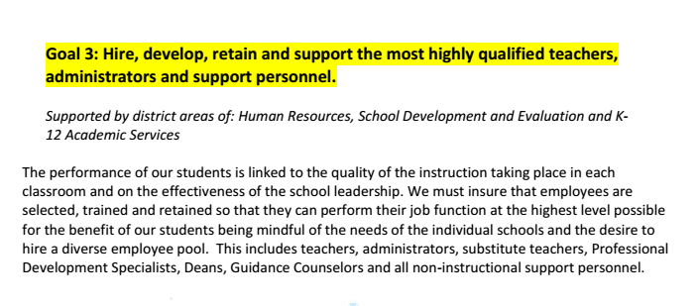
District Strategic Plan
Notes:
Talking Points:
What are the district goals?
District strategic plan - goal was to hire, develop, retain and support highly qualified teachers and personnel

Slide 8

Current Reality
Notes:
Talking Points:
At first, district support for teachers new to education was limited to providing a mentor teacher. While mentoring has many positive effects, we knew it would not be enough to accomplish our goal.

Slide 9
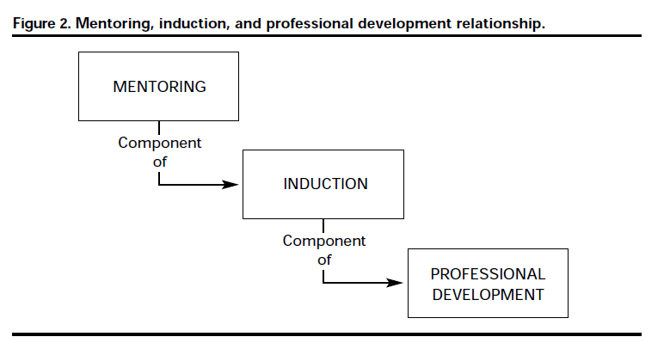
Mind the Gaps
(Wong, 2004)
Notes:
Talking Points:
When we began looking at effective research-based and evidence-based practices, we quickly realized that we needed to develop a more comprehensive induction program in order to meet the needs of our diverse new educators. We looked at many research gurus, like Harry Wong, to help us create a clear picture of what induction should entail.
Induction is a systemwide, coherent, comprehensive training and support process that continues for 2 or 3 years and then seamlessly becomes part of the lifelong professional development program of the district to keep new teachers teaching and improving toward increasing their effectiveness (Wong, 2004). A mentor is a component of the induction process (see Figure 3).

Slide 10
What Is Induction?
Comprehensive
Professional Learning
Collaboration
Notes:
Talking Points:
4-year study conducted in Switzerland, Japan, France, Shanghai (China), and New Zealand by Britton et al. (2003):
1. Comprehensive. Their respective induction approaches are highly structured, comprehensive, rigorous, and seriously monitored. There are well-defined roles of their leadership personnel: staff developers, administrators, instructors, mentors, or formateurs (someone who helps to form a teacher in the French system).
2. Professional learning. The induction programs of the five countries each focus on professional learning, and delivering growth and professionalism to their teachers. They achieve this with an organized, sustained professional development system using a variety of methods. These countries all consider their induction program to be one phase or part of a total lifelong professional learning process, with many components in the induction and greater professional learning process.
3. Collaboration. Collaboration is the forté of each of the five induction programs. Collaborative group work is understood, fostered, and accepted as a part of the teaching culture in the five countries surveyed. There are shared experiences, shared practices, shared tools, and a shared language among all colleagues. And it is the function of the induction phase to engender this sense of group identity and treat new teachers as colleagues and cohorts.
Britton, E., Paine, L., Pimm, D., & Raizen, S. (Eds.). (2003). Comprehensive teacher induction: Systems for early career learning. State: Kluwer Academic Publishers and WestEd.

Slide 11

Notes:
Activity: Have each participant write one important word from what they have learned from the discussion. They then join 3 other people to get their words. Together they write a sentence that incorporates all 4 words. If they chose the same word, they have to explain why that word was so important in their summary sentence.

Slide 12

Early Career Teachers
Professional Development Plan
Notes:
Talking Points:
Our plan targets teachers who are early in their careers (1st-3rd). Depending on the teacher’s experience, we offer a range of supports, some of which are required, and some that are optional. We created this logo to represent the variety of professional development opportunities that we provided through our K-12 Academic Services department.

Slide 13

Supporting & Enhancing Educator Development (S.E.E.D.)
“The vision for Marion County Public Schools’ New Educator program is to acclimate new educators to the profession, using Danielson’s framework as a guide to develop mentorships and professional development opportunities that will ensure our educators not only meet the criteria of the framework for positive evaluations, but guarantee that our students are encountering the best teaching possible every day.”
Notes:
Talking Point: The activities established in the S.E.E.D. packet are designed to align to the MCIES rubric while providing our new educators opportunities to interact with experienced educators to get practical advice on perfecting their practice. Mentors will support the new educator through structured and unstructured activities that prioritize the educator’s needs, as well as participate in or offer training opportunities.
Activity: Choose 3 words or phrases that stand out as the most important. Discuss your choices with a table partner.
Animation: appears on click for example – “acclimate new educators”

Slide 14


S.E.E.D. UNIVERSITY
Notes:
Talking Points:
All teachers in their first 3 years of teaching are encouraged to attend S.E.E.D. University courses. Each course is aligned to a domain on the MCIES Rubric and focused on helping early career teachers improve both their instruction and subject area expertise. Participants will earn $25 per in-seat hour attended, as well as MIP points.
S.E.E.D. courses are designed to be a highly engaging time, where early career teachers learn to implement research-based and evidence-based strategies and practices.
Peer teachers are encouraged to attend S.E.E.D. University courses along with their assigned new teacher. Each hour attended together may be logged on the Peer Teacher – PEC Teacher Time Log. Peer teachers will not be paid a stipend for attending the course, but MIP points may be earned for each in-seat hour attended.

Slide 15
Marion County Instructional Evaluation System (MCIES) Rubric
Notes:
Talking Points:
All sessions are aligned to the induction activities in found in the MCPS Induction S.E.E.D. Handbook, as well as with the Marion County Instructional Evaluation System (MCIES) domains.

Slide 16
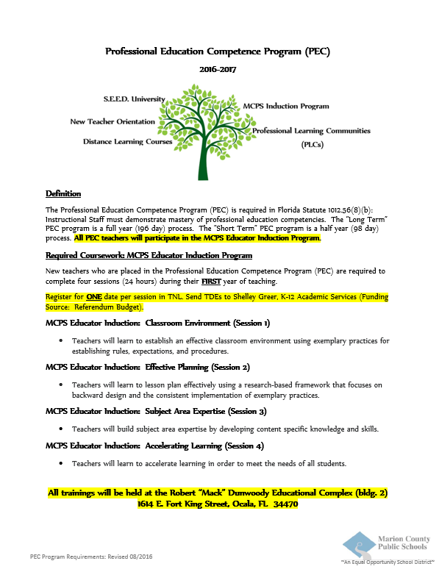

MCPS Induction Program
Notes:
Talking Points: Discuss Required Coursework
Session 1: Classroom Environment – Tools for Teaching: Classroom Management (Fred Jones) & The First Days of School (Harry Wong)
Emphasis on PBS and CHAMPS (Conversation, Help, Activities, Movement, Participation)
Session 2: Effective Planning
Backward design and planning using an instructional framework
Emphasis on being critical consumer of curriculum maps and district resources
Session 3: Subject Area Expertise
Differentiated using online courses through Distance Learning dept.
ESOL and ESE CREDIT opportunities provided
Session 4: Accelerating Learning for All Students
Scaffold Strategies, Challenge Strategies, Differentiated Assignments, Remediation Strategies, and Review Strategies

Slide 17

MCPS Induction Program
Notes:
Talking Points:
(Education Week article – May 16, 2012)
Ballooning – increased student numbers 19% vs. increased employment 48%
Greening – average experience in 1988 was 15 years / 2008 beginner teacher (1 year)
Attrition – 40-50% of new teachers leave within first five years
We use research to determine not only what constitutes effective induction, but also effective teaching practices:
Hattie – Effect Sizes – what works for the student, school, principal, and teacher
Backward Design (Wiggins & McTighe) – planning for learning outcomes
Danielson Framework (MCIES) – evaluating teacher growth and performance
Classroom Environment (Wong, Jones) – exemplary practices for classroom and behavioral management
LEARNING-FOCUSED Instructional Framework – consistent and pervasive framework for continuous improvement

Slide 18
MCPS Educator Induction:
Peer Teachers
A peer teacher is an experienced teacher who holds a valid regular certificate and teaches at the same level, in the same subject area or the same service area as the beginning teacher.
This teacher shall possess the special knowledge and competencies needed to provide adequate support for the development of beginning teachers.
Notes:
MCPS Educator Induction: Peer Teacher training is required for all peer teachers. This training is the foundation for supporting new teachers who are designated as LT PEC through our educator induction program.
In addition, there are opportunities to grow as a mentor through professional learning offerings such as Clin Ed and Advanced Peer Teachers.

Slide 19

MCPS Induction
S.E.E.D. Handbook
Notes:
Talking Points:
MCPS Educator Induction: Peer Teachers – primary resource

Slide 20
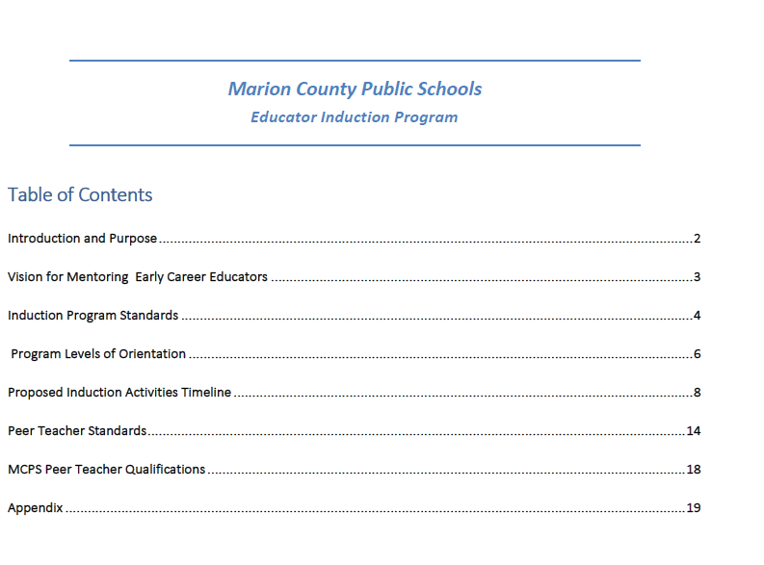
Notes:
MCPS Induction S.E.E.D. Handbook

Slide 21
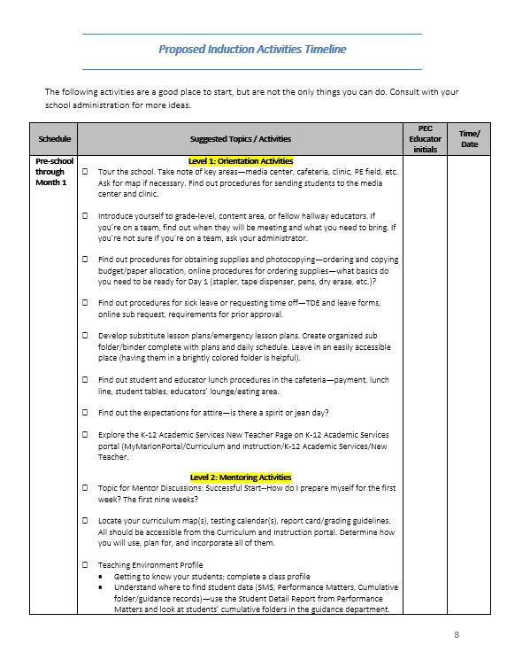
Induction Levels
Level 1: Orientation Activities
  Activities that help to orient the new educator to the school and district. Types and formats of activities vary.
Level 2: Mentoring Activities
  Activities are those designed to be done with the new educator’s assigned mentor, who is chosen based on the mentor guidelines.
  Mentor activities must be logged on a log sheet and total 30 hours of professional development.
Level 3: Professional Growth Activities
  Activities are intended as opportunities for professional development beyond mentoring that the new educator, mentor, or both together can attend to enhance practice and promote continuous improvement.
Notes:
Talking Points:
Level 1: Orientation Activities – School Based
Policies, procedures, resources, and assistance with day to day activities
Level 2: Mentoring Activities – Instruction / Curriculum
Understanding of learning and instruction, collaborate, action research, lesson study
Level 3: Professional Growth Activities – District Level
Enrichment and growth opportunities, PD, S.E.E.D, Distance Learning

Slide 22
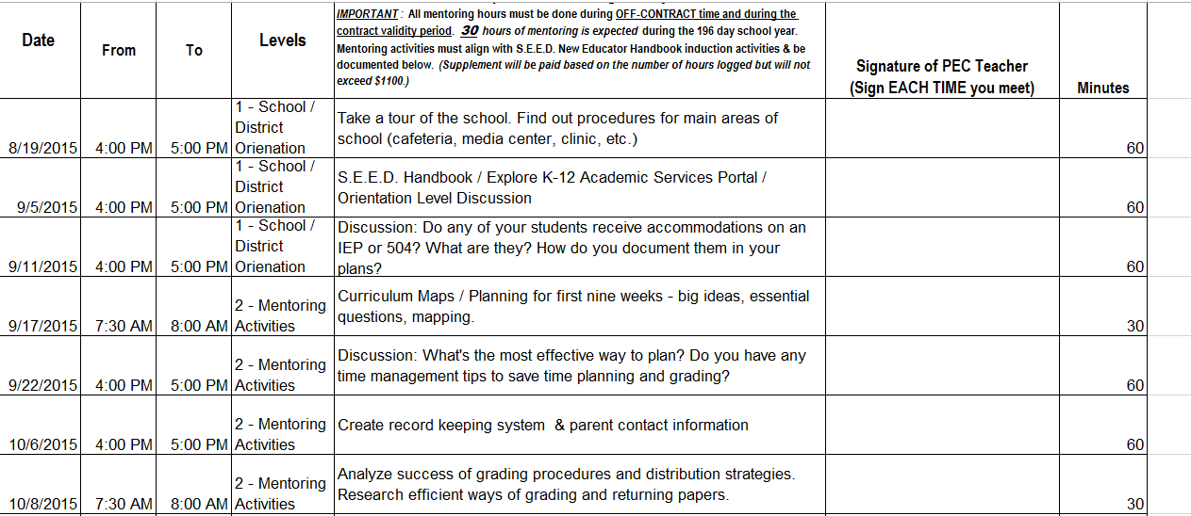
MCPS Educator Induction:
Peer Teachers
Responsibilities of Peer Teacher
  Maintain Peer / Beginning Teacher Time Log – document 30 hours minimum of mentoring hours logged OFF-CONTRACT time.
  Attend 6 hours of Peer Teacher Mentor Training
Notes:
Animation: Example log appears on click

Slide 23

Think-Ink-Pair-Share:
Aha's! & Huh's?
Think & Ink:
Record at least one Aha! & one Huh? on sticky notes (one sticky note per thought)
Pair:
Find a new partner.
Share:
Discuss your Aha’s first. Then share your Huh’s. Thank your partner for their sharing.
Post your sticky notes on the corresponding poster and return to your seats.
Notes:
Activity: Aha’s! & Huh’s? (Need posters for Aha’s and Huh’s to collect thoughts)

Slide 24


New Teacher Orientation
Notes:
Talking Points:
(Voluntary) K-12 Academic Services – “ProfessionalGrowth@K-12Academic Services” focused on introducing the K-12 Academic Services dept. and how we help support teachers with curriculum and instruction.
(Required) MCPS New Teacher Orientation – #GoTeach – focused on introducing major departments and important personnel, as well as providing important information about how to be successful in our district.

Slide 25


#goteach
Notes:
Talking Points:
Tech theme - #GoTeach
Used QR codes to share fun resources
Activity: Visit chat stations around the room and scan QR Codes at each. Discuss how these types of resources help teachers new to teaching or new to the district.

Slide 26
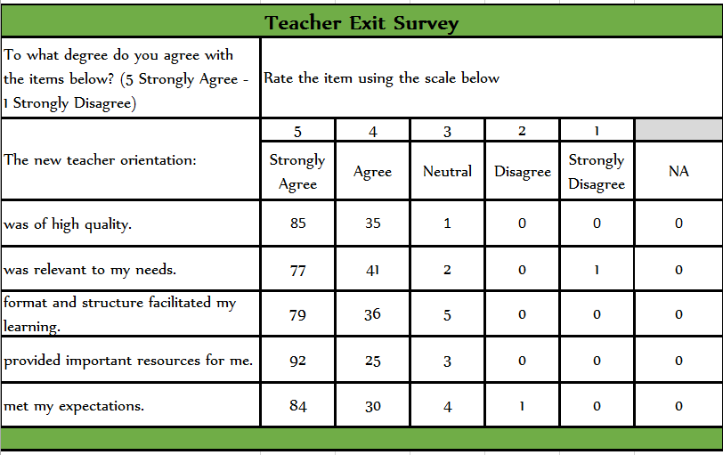
Teacher Feedback
Notes:
Talking Points: Discuss Exit Survey Data from NTOs

Slide 27
What We Learned
Teachers want…
  to be active learners in hands-on sessions.
  to have content differentiated to their specific content or grade level as much as possible.
  more trainings on how to support students with special needs.
  more trainings that utilize and/or focus on technology.
  more trainings on effective lesson planning and using curriculum maps.
Notes:
Talking Points:
Many of these concerns are already addressed through our district Professional Development Plan, the MCPS Induction Program, and through S.E.E.D. University courses.

Slide 28

Notes:
Talking Points:
Overall, we had over 250 new teachers attend orientation on both of our days!

Slide 29



Communication
@MCPSNewTeachers
Notes:
Talking Points:
Frequent contacts with teachers and administrators – including Early Career Teachers page on K-12 Academic Services Portal, monthly newsletters, monthly emails, and new this year – Twitter!
Activity: Post a shout out to our teachers on our Twitter page - @MCPSNewTeachers!

Slide 30

Impact on Teacher Practice
Year 1
Administrator Feedback:
  Creation of MCPS Induction Teacher Kits for each school
  PD Mini-Grants
  Professional Development Specialists on every school campus
Teacher Feedback:
  New S.E.E.D. University Courses
  PLC for Years 2 & 3
  New Teacher Orientation
Notes:
Talking Points: Year 1
Admin Feedback: Requests based on trends in MCIES data
Teacher Feedback: data collected throughout year:
Needs Assessment
Mid Year Check
Wrap Up Survey

Slide 31

Impact on Students
Year 2
Next Steps
Professional Learning Communities:
  Analyze Student Artifacts
  Analyze Lesson Plans
Book Studies:
  Visible Learning for Teachers (J. Hattie)
  Differentiation (R. Wormeil)
Virtual Learning Walks:
  SWIVL Observations
Notes:
Talking Points: Year 2
Differentiation of support by moving from focus on teacher practice to focus on impact on student learning.

Slide 32
Action Plan
 | This Year: | Next Year:
Goals: | Goal 3: Hire, develop, retain and support the most highly qualified teachers, administrators and support personnel. | Goal 3: Hire, develop, retain and support the most highly qualified teachers, administrators and support personnel.
Current Reality: | Mentor teachers provided for teachers in PEC program. | Myriad of professional development courses that align to the MCIES rubric that provide research-based and evidence-based practices and strategies for effective discipline and instruction.
Mind the Gaps: | Induction program needed that is comprehensive and focuses on professional learning through collaboration. | Need to differentiate courses according to experience. Also need to provide more collaborative opportunities across schools and district.
Next Steps: | Year 1: Focus on Teachers - use needs assessment data from teachers and administrators to create and implement a research-based induction program. | Year 2: Focus on Impact on Students - use data from PLCs, book studies, and virtual Learning Walks to increase teacher effectiveness in the classroom.

Slide 33
A Scale for Your Learning
To Do: | Doing: | Done:
Explain importance of a comprehensive, coherent professional development program for new teachers
Analyze your district’s induction program for strengths and weaknesses
Create action steps to increase early career teachers’ effectiveness

Slide 34

Contact Information
Lindsey.Hampton@marion.k12.fl.us
Logan.Johnson@marion.k12.fl.us

