Slide 1
The Planning Period and Beyond…
Seth Edwards, iPD Design Expert
Andrea Pyatt, iPD Facilitator
Amy Cockcroft, Director of Professional Development
Notes:
We introduce ourselves.

Slide 2
September 20, 2016
Agenda
Community Builder
Review the Why
Explore School Models
Discuss Quality Time
Surface Lessons Learned
Next Steps
Find time for job-embedded professional development in your district…
Essential Question
How do we use time as an opportunity?
Learning Goal
Today’s Objective
Educators will discover how time is used as an opportunity for job-embedded professional learning by exploring school models.
Participants will understand how time is an opportunity to improve student outcomes by improving teacher practice.
Notes:
Review Common Board.

Slide 3
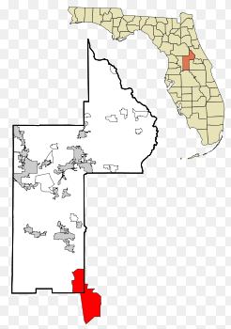
Four Corners
Move to the corner that you are most associated with… (Elementary, Middle, High, District)
Pair up and Talk
Introduce yourself to your partner and share where you are from
Discuss what you would like to take-away from this session
Corner group comes back together.
Be Prepared to Share Out Whole Group from each Level

Slide 4
Lake County Schools
Urban, suburban and rural schools
40 Traditional schools + 7 Charter and Special Focus Schools
Over 44,000 students
61% Free and Reduced Lunch
13% Special Needs
Near bottom of ranking on per student funding in Florida

Slide 5
Why more time?

Slide 6
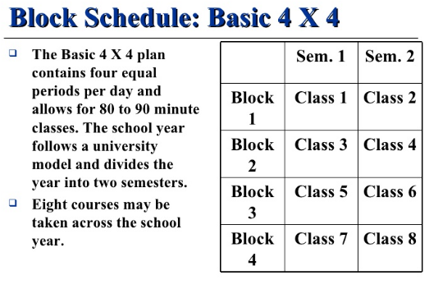
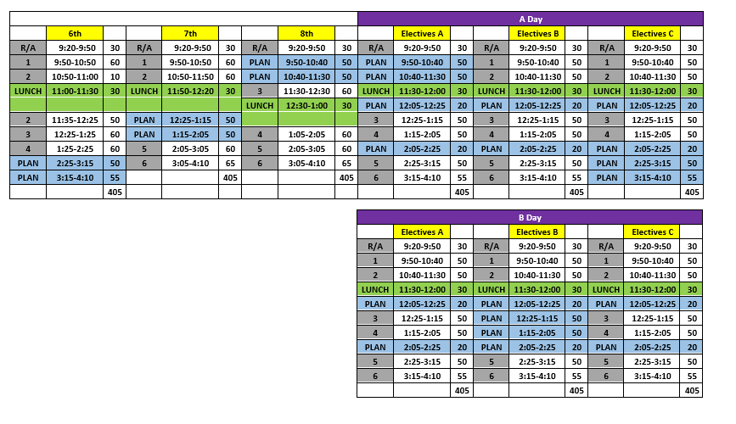
Why a schedule change?

Slide 7
Think about Time
“Time is of the Essence”
As you read, consider…
What portions of the text resonate with you and why?
For what reasons would a school or district leader pursue chunks of time?

Slide 8
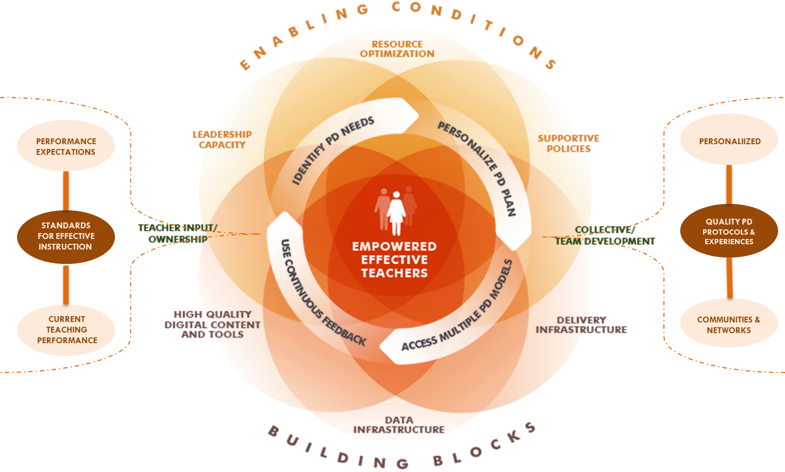

Slide 9
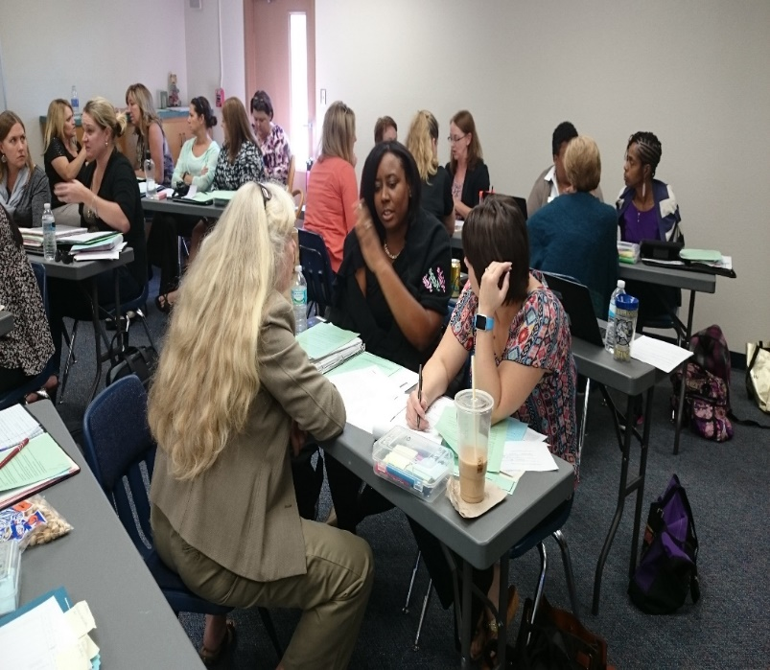
Lake County Schools will design a process for extended, high-quality collaboration and professional learning for teachers and leaders to implement standards-based instruction and improve the quality of teaching and learning.

Slide 10
Ensure all teachers have ample time within the school day for collaboration (without sacrificing quality student learning) focused on core instructional work
Provide multi-modal access to high quality Professional Development content based on teachers’ needs and student results
All teachers have frequent opportunities and multiple sources of feedback on their instructional practice
Assess the impact of Professional Development content and experiences
Quality Time for Teachers
Quality Time for Students
Sustainability
of Systems
innovative
Professional
Development

Slide 11
Ensure all teachers have ample time within the school day for collaboration (without sacrificing quality student learning) focused on core instructional work

Slide 12
Creating the Conditions
Florida’s Class Size Amendment
22/25 students in core classes grades 7-12
Precludes powerful master schedules that optimizes learning for students and teachers
School by Design
Recognized the need for improved conditions for teaching and learning
Allocations posed challenge for collaborative time for teachers
Florida Statute on Blended Learning
Schools using blended learning are not held to the class size cap
Supports Personalized Learning for Students
Notes:
Technical Challenges (Class Size, Personalized Learning) versus Adaptive Challenges (Changing the work – old way to the new way)

Slide 13
School Autonomy
Tight
Standards-Based Instruction
Inconsistent annual instructional time
Inconsistent common planning time
Master schedules varied by school
Collaborative time varied
per school
Loose

Slide 14
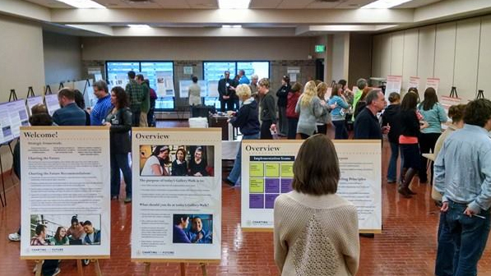
Gallery Walk
Visit the 4 School Models displayed around the room.
While Gallery Walking:
Consider each schools’ model to gain perspective on different plans, strategies, use of resources, successes and challenges…
… keeping in mind what could you do?
Use post-it notes to post questions or insights!

Slide 15
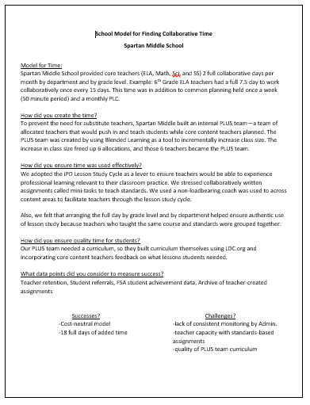
Model A “Spartan Middle School”

Slide 16
Model B “McCue Middle School”

Slide 17
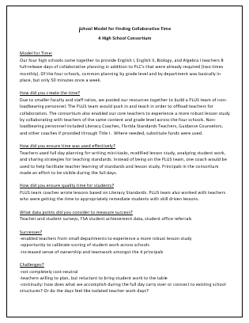
Model C The Consortium

Slide 18
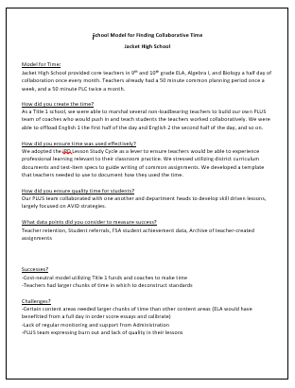
Model D “Jacket High”

Slide 19
What are other districts doing to find time?
Do you have examples of creative schedules?
How are districts creating conditions for job-embedded PD?
Have other districts tried a top-down approach?
Who leads the “finding time” work? Schools? CAO? Superintendent?

Slide 20
Provide multi-modal access to high quality Professional Development content based on teachers’ needs and student results

Slide 21
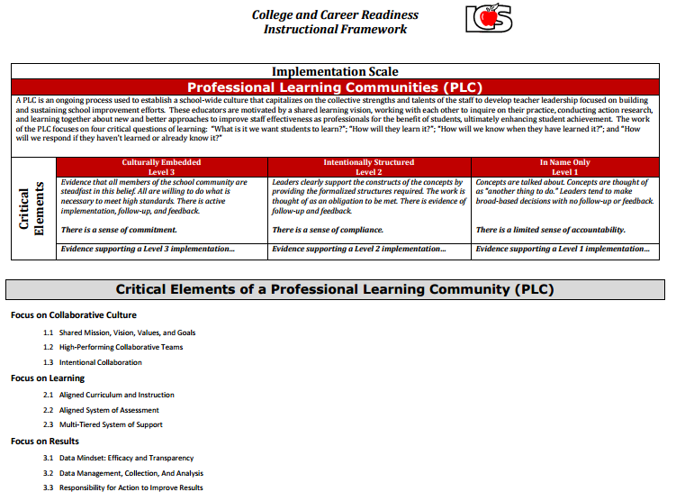
Collaborative Time for Teachers
Collaboration
Learning
Results

Slide 22
How does this cycle compare to the traditional lesson study cycle?
Of the four stages, which stage do you and/or your teachers do really well?
Which stage could have the most impact on student achievement? Explain.

Slide 23
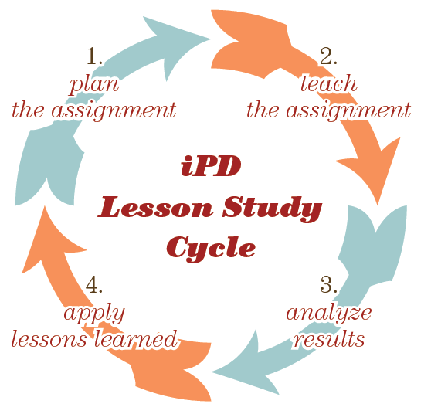
iPD Lesson Study Cycle

Slide 24
Windy Hill Middle School

Slide 25
Principles of Effective PD
A clear focus on learning and learners
An emphasis on individual and organizational change
Small changes guided by a grand vision
On-going professional development that is procedurally embedded

Slide 26
Our current work
Monitoring and Measuring:
Evaluating Efforts and Midcourse Corrections
PD Systems:
A Responsive System
Scaling and Sustainability:
Applying Lessons Learned

Slide 27
Our reflection
Strengths Structures for Collaborative Time Principals participating in Colleague Circles Improved mini-tasks and assignments | Opportunities Alignment of district initiatives Involving all stakeholders in the work Progress monitoring
Questions How do we seat the work so that teachers feel it is not one more thing? How do we bridge the necessary pieces of traditional professional development with innovative professional development? | Challenges Consistency in common language across the district Changing the landscape of professional learning and breaking out of the traditional framework

Slide 28
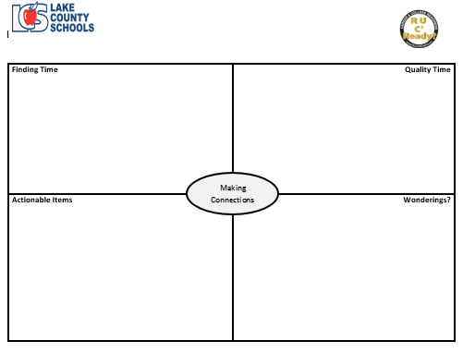
Making Connections

Slide 29
September 20, 2016
Agenda
Community Builder
Review the Why
Explore School Models
Discuss Quality Time
Surface Lessons Learned
Next Steps
Find time for job-embedded professional development in your district…
Essential Question
How do we use time as an opportunity?
Learning Goal
Today’s Objective
Educators will discover how time is used as an opportunity for job-embedded professional learning by exploring school models.
Participants will understand how time is an opportunity to improve student outcomes by improving teacher practice.
Notes:
Review Common Board.

