Slide 1
Connect with CPALMS via Social Media
 | www.facebook.com/icpalms
 | @tweetcpalms
 | pinterest.com/icpalms
 | Standard/Benchmark lookup by SMS! Text a standard number (e.g., SC.8.N.1.2) to 850-846-6868 and CPALMS will text you back with the description.

Slide 2
www.cpalms.org
Using CPALMS for Professional Development
Glenna Barber
gbarber@lsi.fsu.edu

Slide 3
Workshop Goals
Become familiar with the Professional Development Modules on CPALMS
Learn to navigate CPALMS and explore modules and resources which can be used for Professional Development
Explore the Beyond the Standards Math K-5 Video Series and Perspectives Videos

Slide 4
Resource Review Process
A review process designed for providing professional development for submitters and dedicated for creating high-quality resources for use by our educators.
Review Areas
Expert teachers
Content accuracy
Effective presentation
Pedagogy
+
Subject area experts
An average of
5 reviews per resource
Standards- alignment
Appropriateness for target audience
Specialty

Slide 5
Variety of Resource Types
Lesson Plans and Units
Math Formative Assessments
Standards aligned and vetted
MEA STEM Lessons & Activities
Text Complexity
Problem-solving Tasks
Data Sets
Lesson Study Resource Kits
Virtual Manipulatives
Perspectives Video Series
Educational Games
Student Resources
Professional Development Modules

Slide 6
Few of the Tools on iCPALMS Currently only available to FL educators
CMAP Curriculum Planner
More than 700,000 curriculum plans have been created using the CMAP
Lesson Study Support System
Standards Visualizer
120,000 Florida educators
have an account
My Resources Center
Professional Development System
Several others

Slide 7
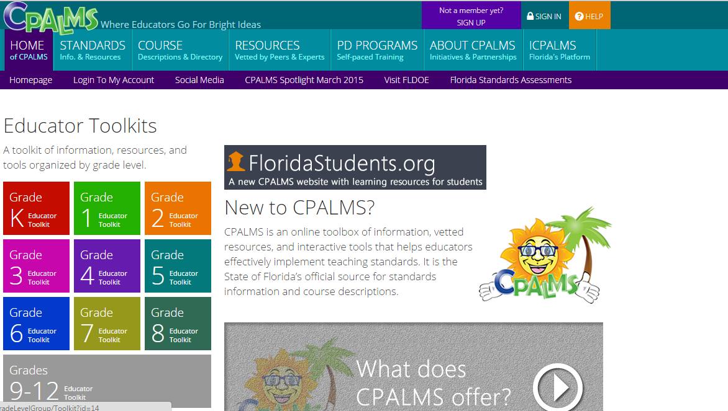
CPALMS Home

Slide 8
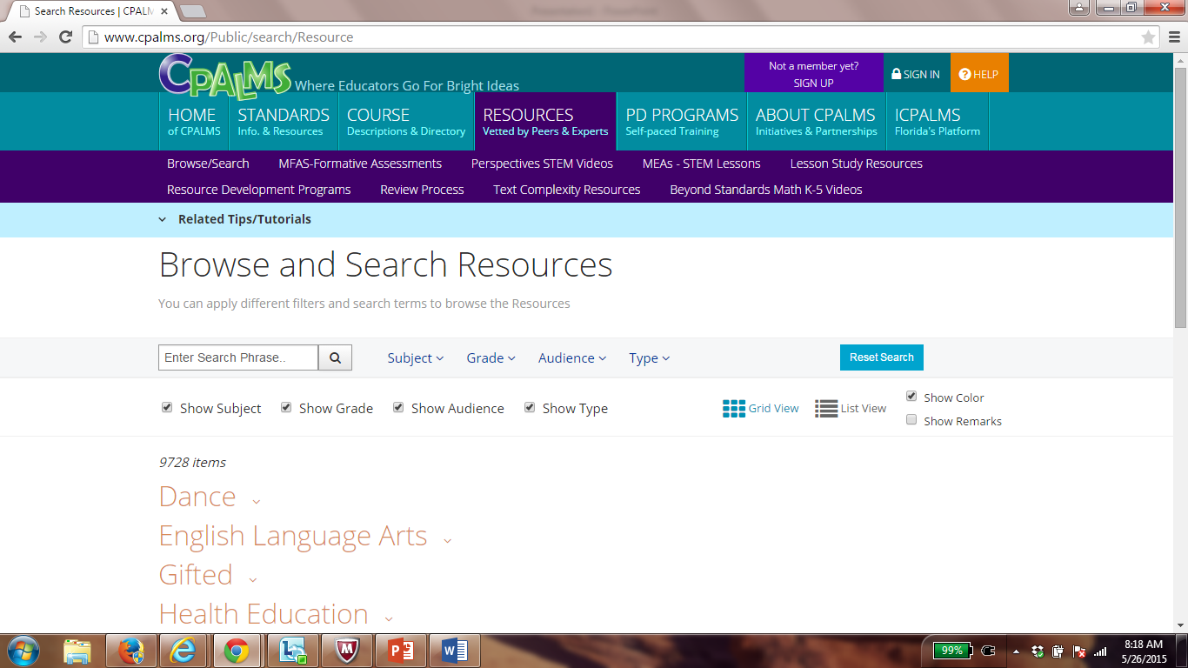
Resources

Slide 9
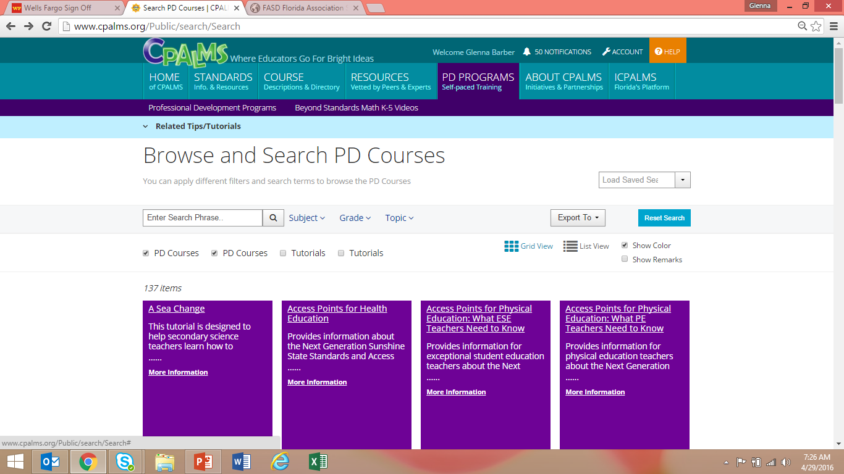
Professional Development Modules

Slide 10
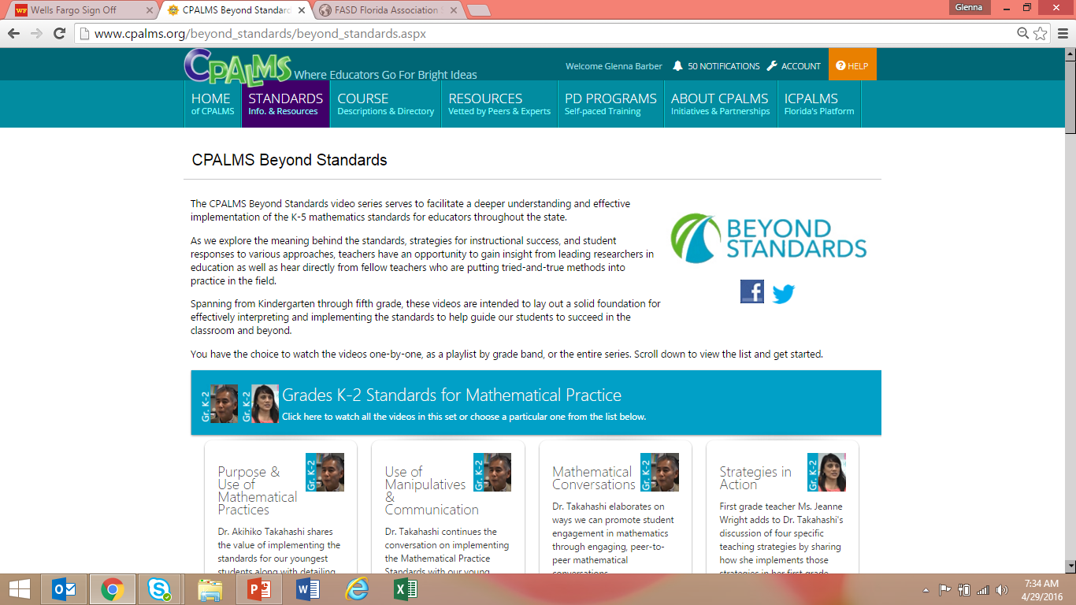
Beyond Standards Math K-5 Videos

Slide 11
Math Formative Assessment System (MFAS) PD Modules

Slide 12
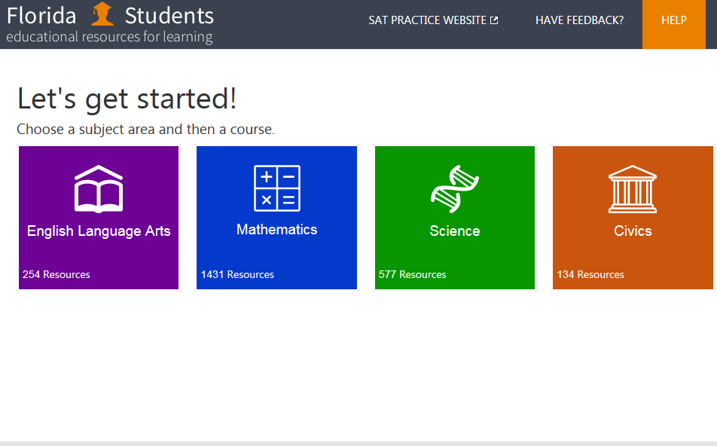

Slide 13
3D Lessons Coming Soon

Slide 14
Provide feedback on this session: http://www.cpalms.org/pd/feedback.aspx
Presenters: Glenna Barber
Next Steps
Locate and export your course descriptions
Explore the resources on CPALMS
Get ready for a Great Year!

