Slide 1
SIOP Implementation in Manatee County
A Title I and Title III Partnership
Presented by: Debra Estes, ESOL Coordinator

Slide 2
By the numbers……
26 % of the students in Manatee County Schools are ELL
30 % of the students in Title I schools are ELL
33%-60% of the students are ELL at half of our Title I schools.
13 Title I schools have between 100-370 ELL students

Slide 3
Title I – WE ARE ELL!
This is NOT differentiation
ELL is who we are
Image from a recent parent night

Slide 4
So WHAT IS SIOP?
The Sheltered Instruction Observation Protocol (SIOP) is a school reform effort focused on the development of academic language and literacy skills within the content areas.
All lessons have language and content objectives
It consists of 8 components and 30 features designed to address core instruction and best practices for English Language Learners.
SIOP teachers explicitly teach academic language and provide opportunities for students to practice that language. (All four language skills are taught and practiced: listening, speaking, reading and writing).

Slide 5
SIOP Sheltered Instruction Observation Protocol
SIOP is a framework for lesson planning and delivery that makes content comprehensible while actively developing students’ academic language.
1. Lesson Preparation
2. Building Background
3. Comprehensible Input
4. Strategies
5. Interaction
6. Practice & Application
7. Lesson Delivery
8. Review & Assessment
Notes:
SIOP is a framework for lesson planning and delivery that makes content comprehensible while developing academic language.
SIOP consists of 8 components. Within these eight components, there are 30 features.
SIOP does not claim to own these teaching practices. We knew many of them before they were grouped under the SIOP umbrella.
After years of research and classroom observation, these 30 features have been proven to improve academic performance of ELLs and other students.
Best practices grouped together with the focus on developing academic language.

Slide 6
STANDARDS
WHAT
WE TEACH
SIOP
HOW
WE TEACH
Notes:
We live in the era of standards-based instruction. We do not choose what we teach. We do have the choice in HOW we teach though.
We want to share with you some examples from SIOP classrooms that make instruction more comprehensible to ELLs (and other students as well).
We will look at examples of SIOP in action in our classrooms. There will be several groups of pictures. After each one, we will give you a chance to discuss it at your table and/or ask questions.

Slide 7
The SIOP Implementation Plan
SIOP implementation is a three year plan consisting of
a planning year,
implementation year 1,
and
implementation year 2

Slide 8
Planning Year
ELL staff presentations at the school site
Advance team attends SIOP training
Whole staff participates in a book study.

Slide 9
Implementation Year 1
3-day SIOP overview training (8 components introduced),
4 follow up component enrichment workshops (Saturdays)
2 on-site coaching sessions with on-going support from ESOL and other Specialists.
4 hours of paid planning for each follow up component

Slide 10
SIOP Training

Slide 11
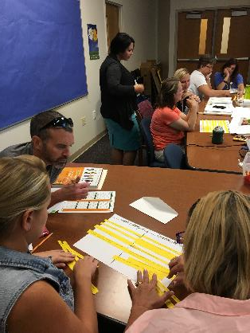
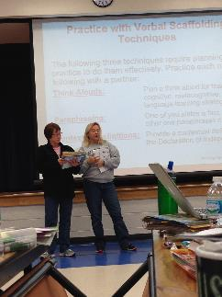
SIOP Training

Slide 13
Implementation Year 2
2 follow up component enrichment workshops
2 on-site coaching sessions with on-going support from ESOL and other District Specialists.
Collaborative Planning by grade level team

Slide 14
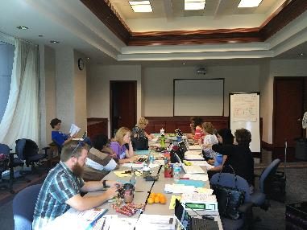
SIOP Collaborative Planning

Slide 15
Building Capacity
Trained instructional coaches, teachers from Prine EL, district personnel to support the school in SIOP implementation
District staff, select teachers and select coaches attended Train-the-Trainer and inter-rater reliability training in the use of the protocol

Slide 16
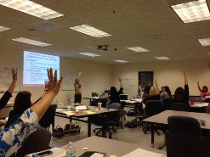
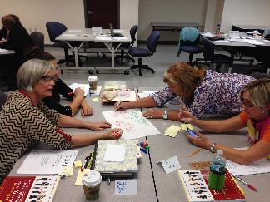
SIOP Training: Building Capacity of District Personnel

Slide 17
Collaboration Across Programs
Title I, Part A and Title III Funding was used to
purchase materials
pay teacher stipends for training outside of the contracted hours,
pay for substitute teachers for follow-up coaching sessions.

Slide 18
Collaboration Across Programs
The use of both funding sources was written into both the Title I and Title III grants.
Future plans include the use of Schools Improvement and/or Title II funds in order to expand the SIOP training to high needs schools and non-Title I schools.

Slide 19
BONUS: SIOP totally alignes with the Teacher Evaluation System

