Slide 2
Evidence-Based Leadership
The Missing Link to Results:
Teacher & Employee Engagement
May 2, 2016
Dr. KK Owen, Leader Coach

Slide 3
What do we know about employee engagement?

Slide 4
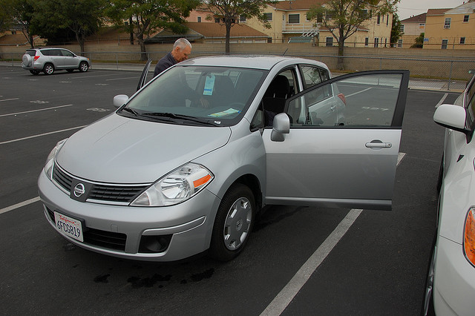

Slide 5
What does research tell us?

Slide 6
Lack of Teacher Engagement = 2.3 Million Missed Days

Slide 7
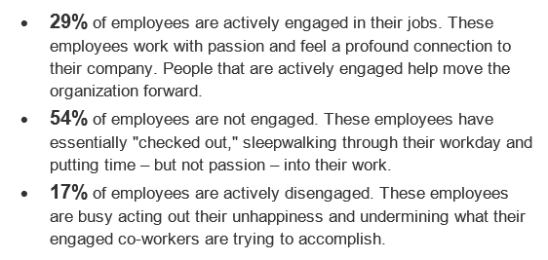
Recognizing Engagement & Disengagement

Slide 8
What does the evidence say?
A recent meta analysis of employee engagement studies published in the Journal of Applied Psychology found that…
High employee engagement is positively correlated with:
Increased customer satisfaction
Increased productivity
Increased results
Reduced employee turnover
Reduced absenteeism
1. Harter, J.K., Schmidt, F.L., & T.L. Hayes. (2002). Business-unit-level relationship between employee satisfaction, employee engagement, and business outcomes: A meta-analysis. Journal of Applied Psychology, 87(2), pages 268-279.

Slide 9
What does the evidence say?
According to surveys conducted by Gallup, organizations with highly engaged employees enjoy:
65% less turnover in low-turnover organizations
25% less turnover in high-turnover organizations
37% less absenteeism
Gallup, Inc. (2015). Retrieved from: http://www.gallup.com/services/169328/q12-employee-engagement.aspx

Slide 10
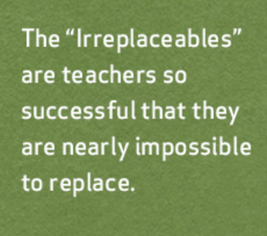
Who are your “Irreplaceables”?
tntp.org

Slide 11
Is it possible to replace an Irreplaceable?

Slide 13
The Role of the Leader in Engagement

Slide 14
Mary Jo Raczkowski-Shannon Principal, Hunt Elementary School Jackson Public Schools, Michigan

Slide 15
Are you an “engaged” leader/teacher/employee?”
Inspired by his/her organization
Willing to invest discretionary effort
Likely to recommend the employer
Planning to stay for the foreseeable future

Slide 16
How Engaged Am I? Team Member Self-Assessment

Slide 17
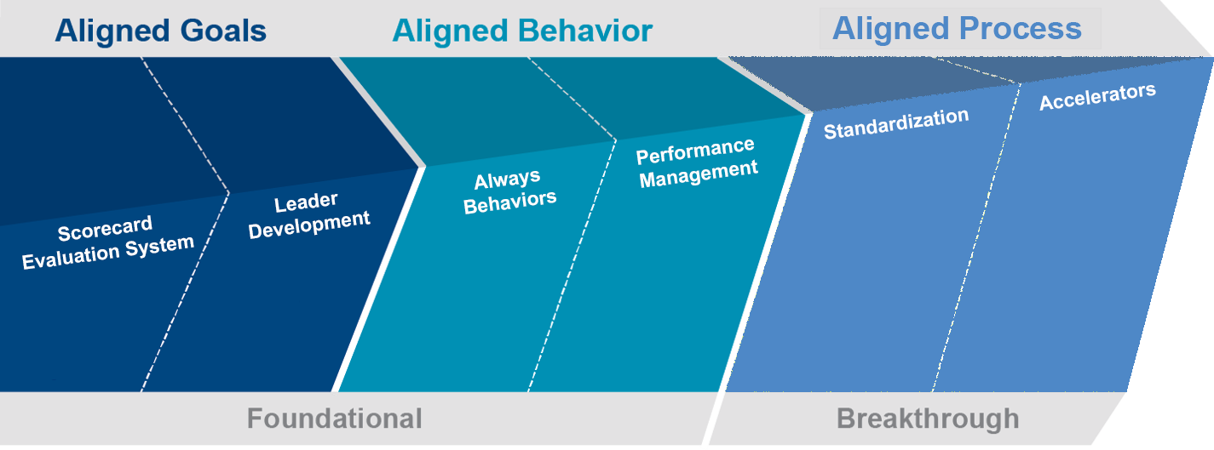
Educational Framework: Evidence-Based LeadershipSM
Scorecard

Slide 18
Organizational Flywheel
Always Actions

Slide 19
Employees want to have purpose, do worthwhile work that makes a difference. This truth is at the heart of our drive to lasting results.
Results That Last, Quint Studer, Chapter 4, Pg 55

Slide 20
What are Employees Looking For in Their Leaders?
A good relationship
Approachability
Willingness to work side by side
Efficient systems
Training and development
Resources to do the job
Appreciation

Slide 21
Why do employees leave?
The job or workplace was not as expected
The mismatch between job and person
Too little coaching and feedback
Too few growth and advancement opportunities
Feeling devalued and unrecognized
Stress from overwork and work-life imbalance
Loss of trust and confidence in senior leaders
The 7 Hidden Reasons Employees Leave - Leigh Branham, 2005

Slide 22
How Can Leaders Maximize Engagement?
Know your Employees Engagement Status
Re-recruit High Performers
Reward and Recognize “what right looks like”

Slide 23
Diagnosing Engagement Levels
Quadrant 1
Loyal
Quadrant 2
Want to be aligned
Quadrant 3
Skeptical
Quadrant 4
Naysayer

Slide 24
High Performer Conversation
Re-recruit-outline why they are so important
Tell them where the organization is going
Recognize-thank them for their work
Ask-What can I do for you?

Slide 25
Reward & Recognition
What Does the Evidence Say?

Slide 26
What does the evidence say?
A recent study published in the Interdisciplinary Journal of Contemporary Business reviewed existing literature and found that…
Employees do their best work when they feel that their hard work will be rewarded by their manager.
Gohari, P., Kamkar, A., Hosseinipour, S.J., & M. Zohoori. (2013). Relationship between rewards and employee performance: A mediating role of job satisfaction. Interdisciplinary Journal of Contemporary Research in Business, 5(3), pages 571-597.

Slide 27
Reward and Recognition: General Themes
A recent study published in the Interdisciplinary Journal of Contemporary Business reviewed existing literature and found that:
Reward and recognition programs stimulate creative performance
Both tangible (monetary) and non-tangible rewards (a verbal “thank you”) have positive effects on employee commitment and motivation
Lack of reward and recognition is a “crucial” reason for employee turnover
Gohari, P., Kamkar, A., Hosseinipour, S.J., & M. Zohoori. (2013). Relationship between rewards and employee performance: A mediating role of job satisfaction. Interdisciplinary Journal of Contemporary Research in Business, 5(3), pages 571-597.

Slide 28
The Power of Thank You Notes

Slide 29
Thank you notes-call to action!

Slide 30
http://go.globoforce.com/rs/globoforce/images/Mood_Tracker_Spring2012-final_2.pdf

Slide 31
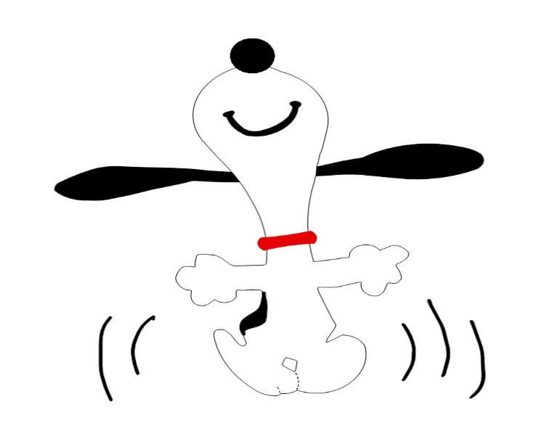
What Gets Recognized Gets Repeated!
“creating a best place to work”
“creating a great place to learn”
“creating a great place for parents to send their children for a quality education”

Slide 32
Reward and Recognition
Formalize the Informal
Talk with a partner:
What will you say/do?
When will you say/do?
How will you reward/recognize?
People like to be recognized…

Slide 33
A Leader’s Primary Job
Culture of
Engagement

Slide 34
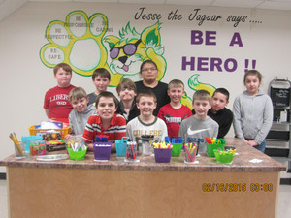
“Always bring it back to values..."
— Quint Studer

Slide 35
Thank you for your engagement today!
Contact Information:
karen.owen@studereducation.com
850-898-3883 www.studereducation.com

Slide 36
Looking to learn more?
Join us August 1-2!
Questions?
karen.owen@studereducation.com

